Slide 1
Jane Weber: author, conservationist, gardener, environmentalist, tea grower, traveler, writer…
352 249 6899 jweber12385@gmail.com Facebook.com/janeweber.3939

Slide 2
Jane Weber is semi-retired but ever a writer, environmentalist, gardener, casual birder and traveler.
Once called an “Adventure Addict” by Sailing Magazine, this great Grandmother has traveled solo, long-term in more than 100 sovereign nations and thousands of destinations worldwide.
She has driven, ridden, biked, hiked, flown and/or sailed hundreds of thousands of miles in all 50 USA states, 10 Canadian provinces, 2 territories, and more, in all 4 countries and territories in North America Now based in Central Florida, Weber posts her adventures and misadventures on Facebook while traveling.

Slide 3
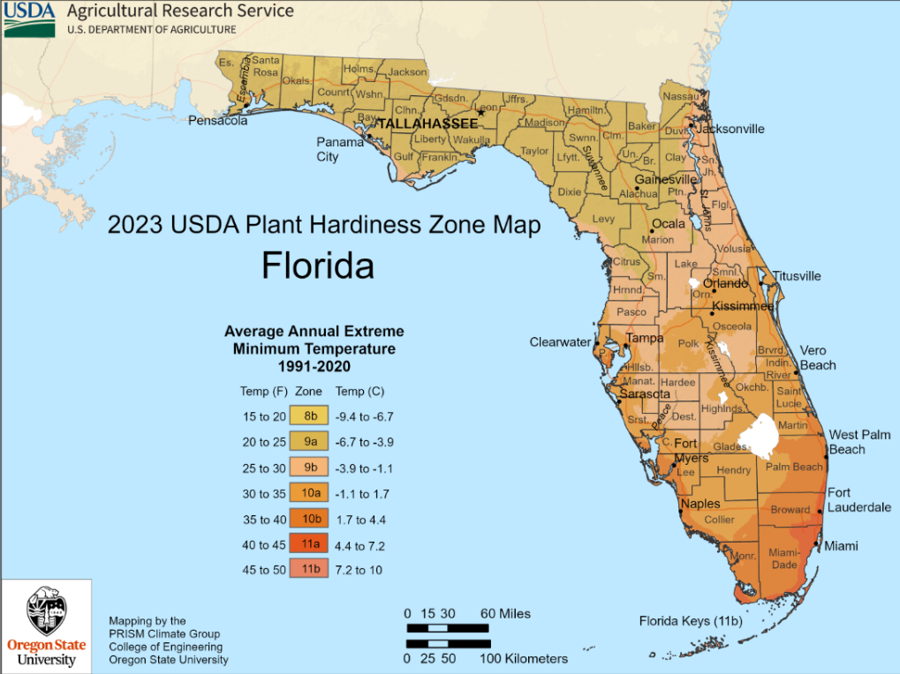
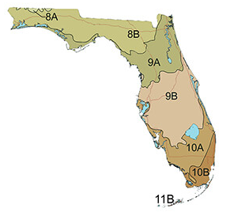
USDA Plant Hardiness Zone Interactive Map - with zip code search
Plant Hardiness Zones © 2023 University of Florida, IFAS Last Modified: 12 Jan 2023 09:45:05 EST

Slide 4
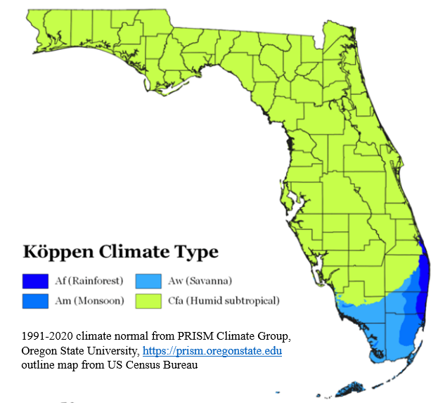
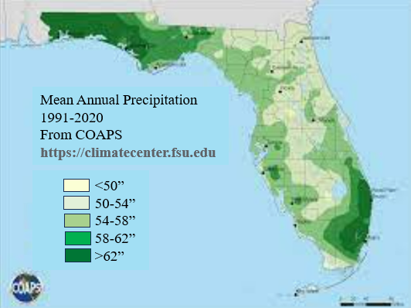
Coastal Citrus County averages 54-58” of rain.
Eastern inland Citrus County averages 50-54”
The summer rainy season starts in June and ends about October
The driest months are April through May until the rainy season begins
No part of the continental USA is within tropical latitudes
Most of Florida has a humid subtropical climate.
Tropical plants cannot survive frosts and freezing

Slide 5
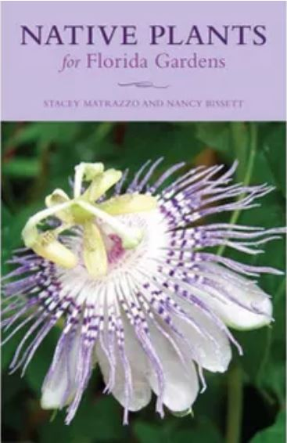
2003 2005 2019 2020 2021
Older books are a wealth of information but are accurate only up to the date of publication.
Check online, from a reliable source, for up-to-date scientific names, new scientific research... Reliable, up-to-date sites include Encyclopedia Britannica, Alabama.butterflyatlas.usf.edu, Cornell.edu. UF, Butterfliesandmoths.org, iNaturalist, Wikipedia and other updated sources.
2017

Slide 6
Always research on reliable updated sites like:
Britannica.com 2023 11 24
Gymnosperm, any vascular plant that reproduces by means of an exposed seed,
—unlike angiosperms, or flowering plants, whose seeds are enclosed by mature ovaries or fruits.
The seeds of many gymnosperms (literally, “naked seeds”) are borne in female cones and are not visible until maturity.
Taxonomists recognize four distinct divisions of extant (nonextinct, living) gymnospermous plants
— Pinophyta, Cycadophyta, Ginkgophyta, and Gnetophyta —
with 88 genera and more than 1,000 species distributed throughout the world.
Gymnosperms were dominant in the Mesozoic Era (about 252.2 million to 66 million years ago),
during which time some of the modern families originated (Pinaceae, Araucariaceae, Cupressaceae).
Wikipedia 2023 08
“Ferns first appear in the fossil record about 360 million years ago in the
late Devonian period (419.2 to 358.9 million years ago) (MYA)
but Polypodiales, the group that makes up 80% of living fern diversity,
did not appear and diversify until the Cretaceous (145 – 66 MYA)
contemporaneous with the rise of flowering plants that came to dominate the world's flora.”
nps.gov 2023 04 27 National Park Service (NPS) Cretaceous Period 145 - 66 MYA Angiosperms (flowering plants) appeared in the fossil record more than 100 MYA during the Cretaceous.
Once they appeared, they quickly became the dominant type of plant life on land and remain so today.
The earliest angiosperms evolved from a specialized group of seed ferns.

Slide 7
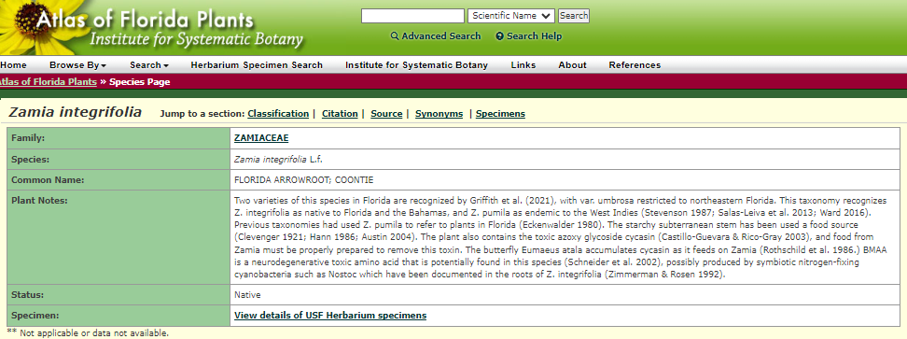
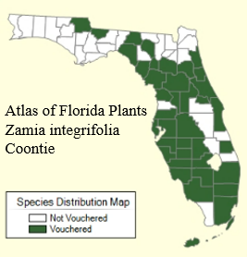
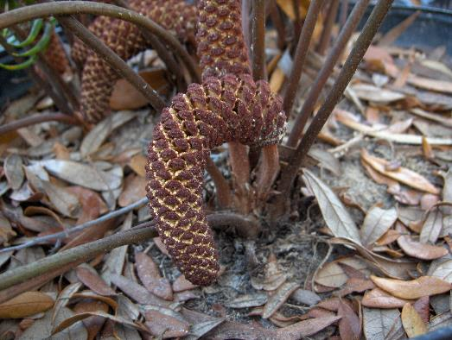
Two varieties of this species in Florida - Griffith et al. (2021), with Z. integrifolia var. umbrosa restricted to northeast Florida. This taxonomy recognizes Zamia integrifolia as native to Florida and the Bahamas, and Z. pumila as endemic to the West Indies
Atlas of Florida Plants Zamia integrifolia, Coontie

Slide 8
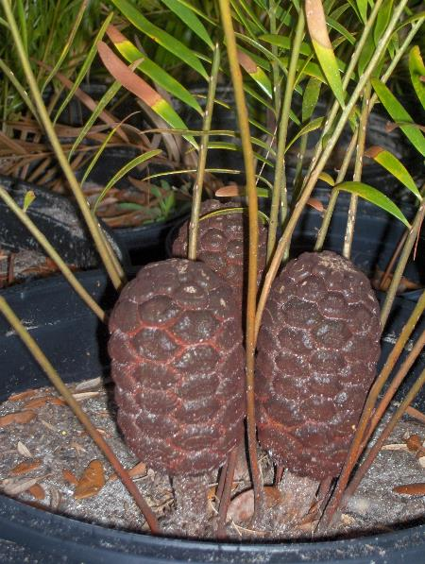
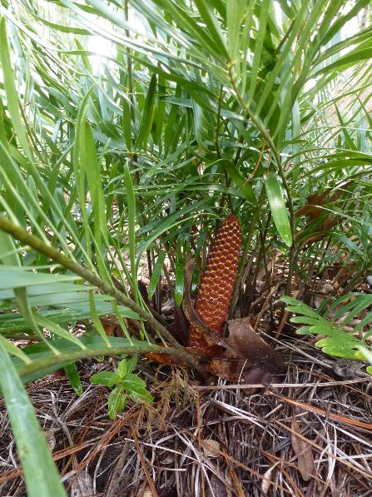
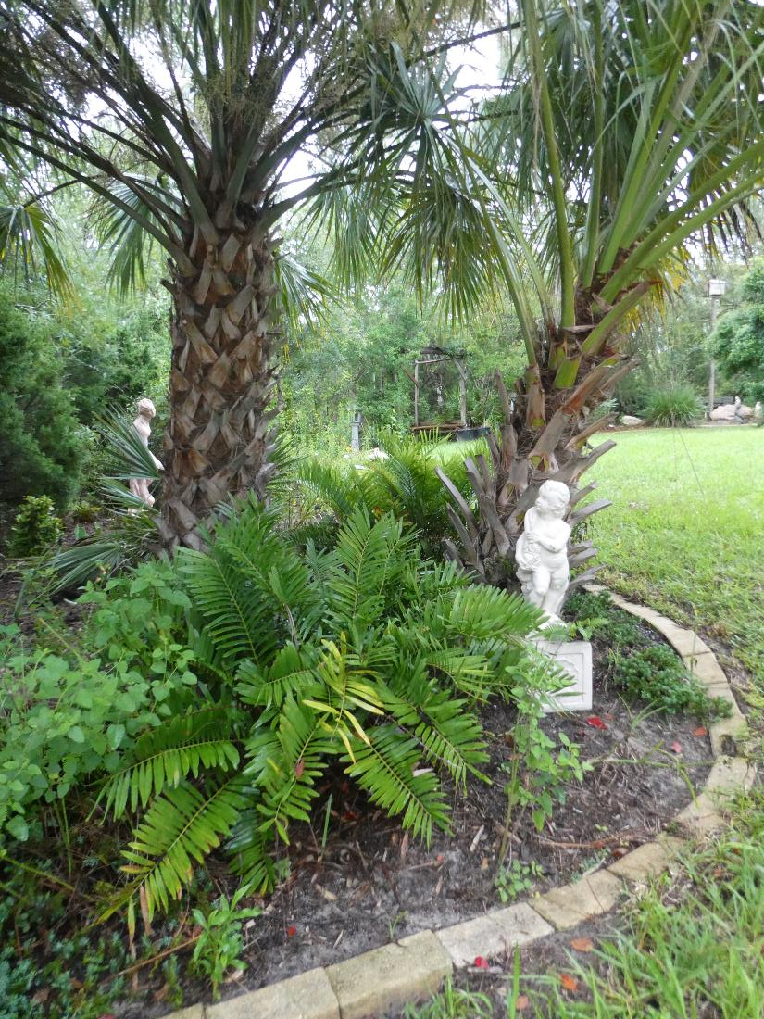
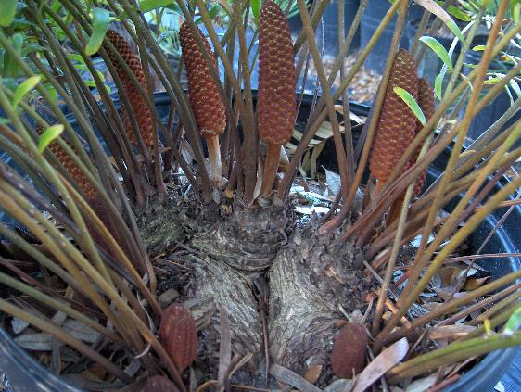
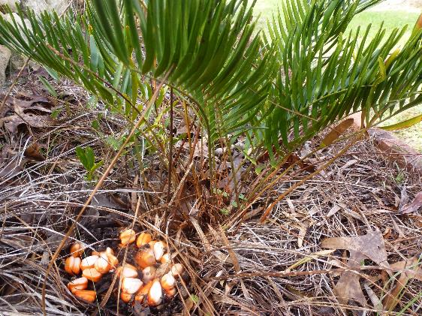
Zamia integrifolia, Coontie is a cycad gymnosperm NOT A PALM

Slide 9
Zamia integrifolia, Coontie is a cycad gymnosperm NOT A PALM

Slide 10
Wikipedia:
“Like other cycads, Zamia integrifolia is poisonous, producing a (neuro)toxin that affects the gastrointestinal tract and nervous system. The toxin can however be removed by careful leaching, and the roots and half-buried stems of this cycad were used by Native American people (notably the Tequesta and Mayaimi Indians, the Seminole Indians and the Maroons) to produce this starch. The root is typically prepared by grinding (macerating) it using a wooden mortar and pestle. The pulp is then saturated in water and drained. The drained fluid is allowed to dry, and the resulting yellowish powder is used in the preparation of various foods.
In commercial production, multiple macerations achieved a whiter color.
Commercial production of the starch (using roots gathered from wild plants) occurred in South Florida, from the 1830s until the 1920s.
(Zamia integrifolia Coontie) starch was sold as Florida arrowroot until the Food and Drug Administration banned the practice in 1925. The last commercial "coontie starch" factory in Florida was destroyed by the 1926 Miami Hurricane.”

Slide 11
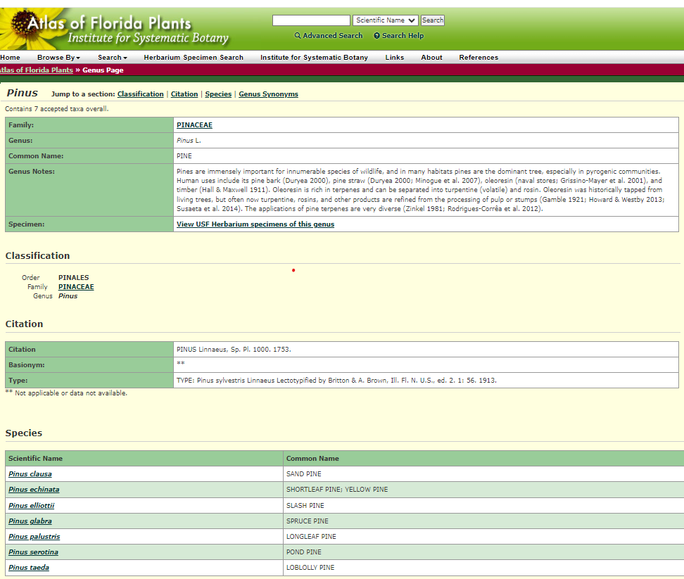
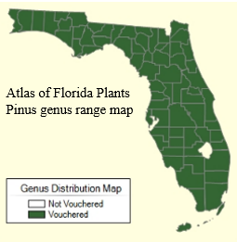
Florida has 7 species of native pine trees
Check their range at the online plant atlas Atlas of Florida Plants
University of South Florida family of PlantAtlas.org websites

Slide 12
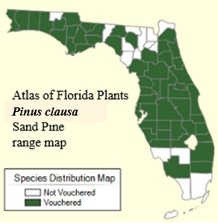
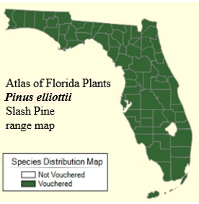
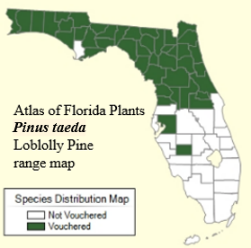
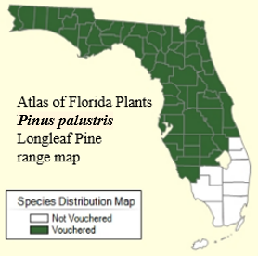
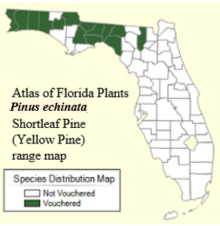
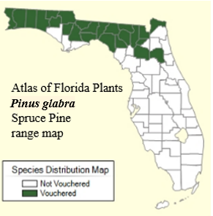
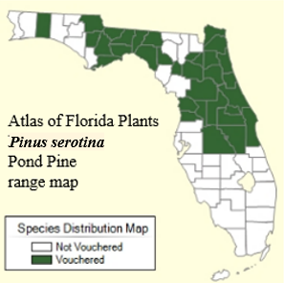
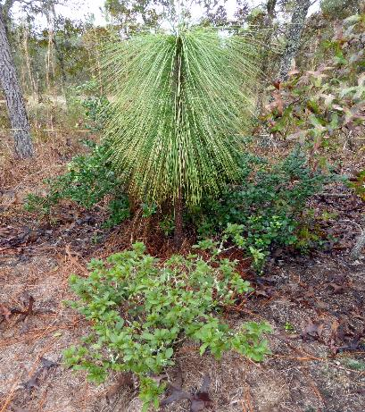
4 species of native pines commonly grow in Citrus County. Long leaf pine (Pinus palustris)stays in its juvenile grass stage for at least 8 years.
It needs periodic fires to help clear out faster growing Slash Pines (Pinus elliottii)
For more information, contact: Richard Wunderlin or Bruce Hansen, Alan Franck, or Karla Alvarado
© 2024 Institute for Systematic Botany | Data last modified: 1/25/2024 Web Development: USF Water Institute
A member of the University of South Florida family of PlantAtlas.org websites

Slide 13
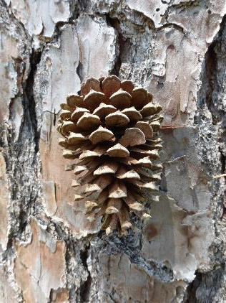
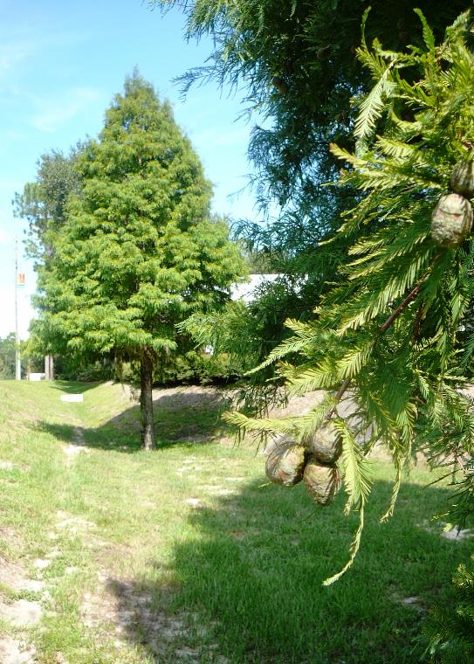
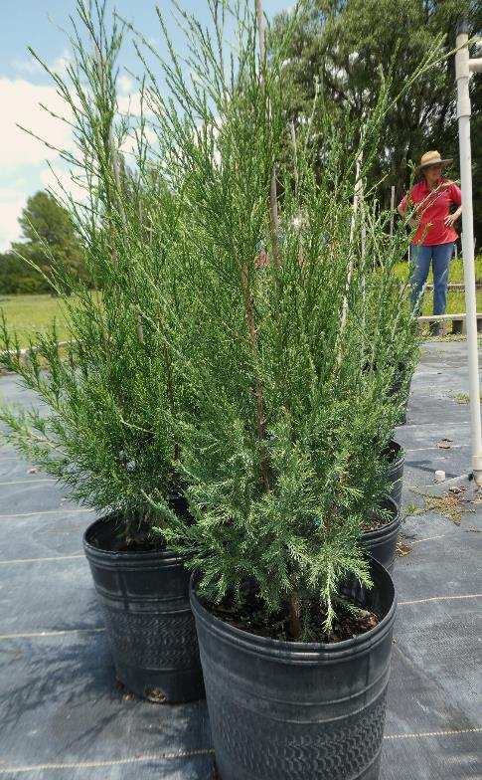
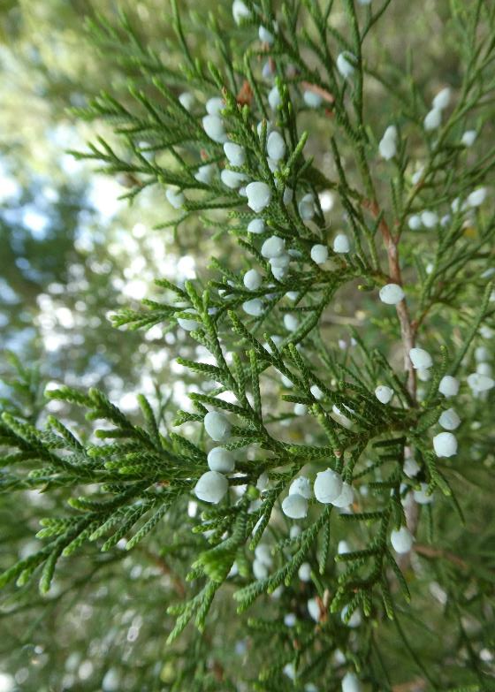
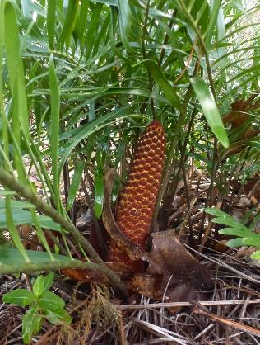
Gymnosperms evolved before angiosperm flowering plants. Araucaria, cycad, cypress, fir, ginkgo, juniper, larch, pine, spruce, torreya, etc. are gymnosperms with naked seeds in cones. Florida has 7 species of native perennial evergreen pine trees (Sand, Slash, Longleaf, Loblolly, Pond, Spruce & Shortleaf/Yellow); 2 species of cypress (Pond and Bald); one cycad (Coontie) and one critically endangered Torreya taxifolia.
Pinus taeda
Loblolly cone, female
Taxodium distichum Bald Cypress
lives up to 600 years
Juniperus virginiana
Juniper Redcedar
Juniperus virginiana
Juniper cones, female
Zamia integrifolia
Coontie cone, male

Slide 14
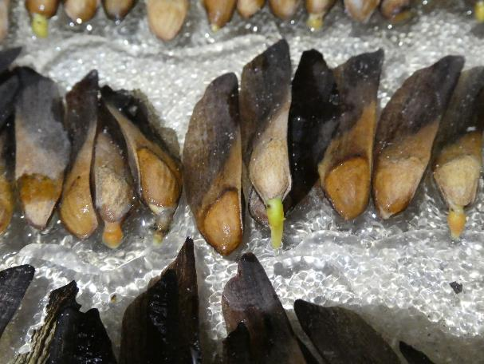
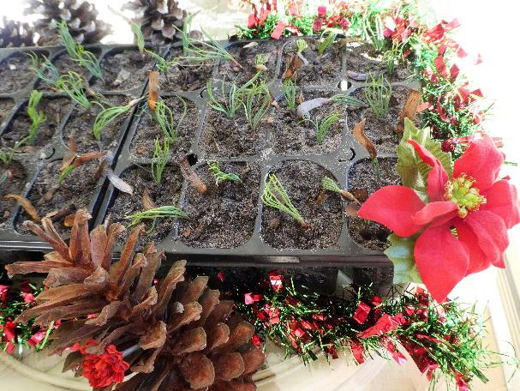
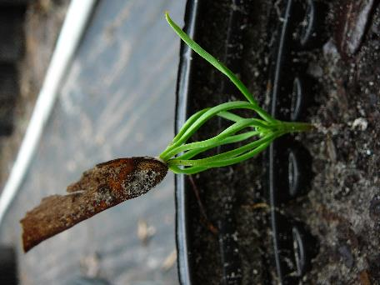
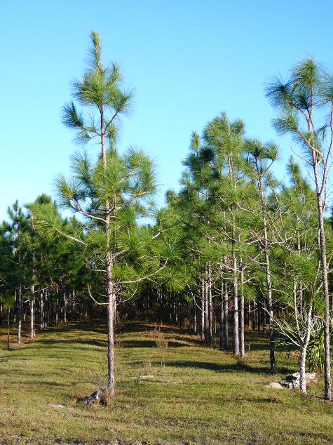
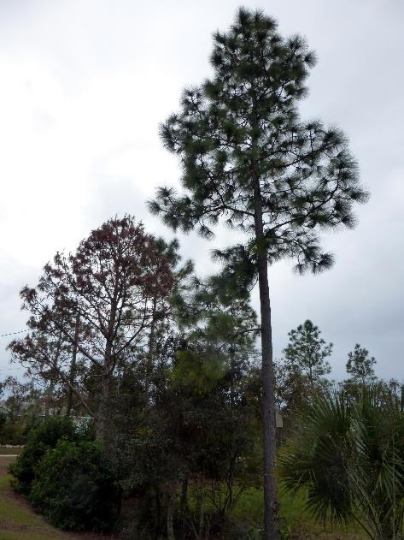
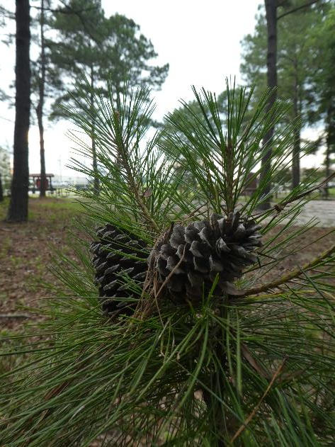
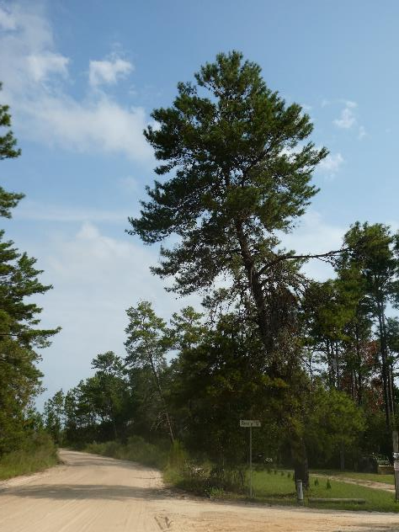
Pinus palustris Longleaf
Out of the grass stage
About 9-10 years old
Pinus palustris Longleaf Pine seeds
Pinus palustris Longleaf Pine
Pinus taeda Loblolly Pine
Pinus clausa Sand Pine
Pinus elliottii Slash Pine
Pinus palustris Longleaf Pine

Slide 15
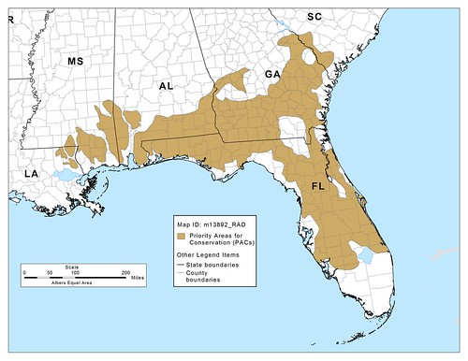
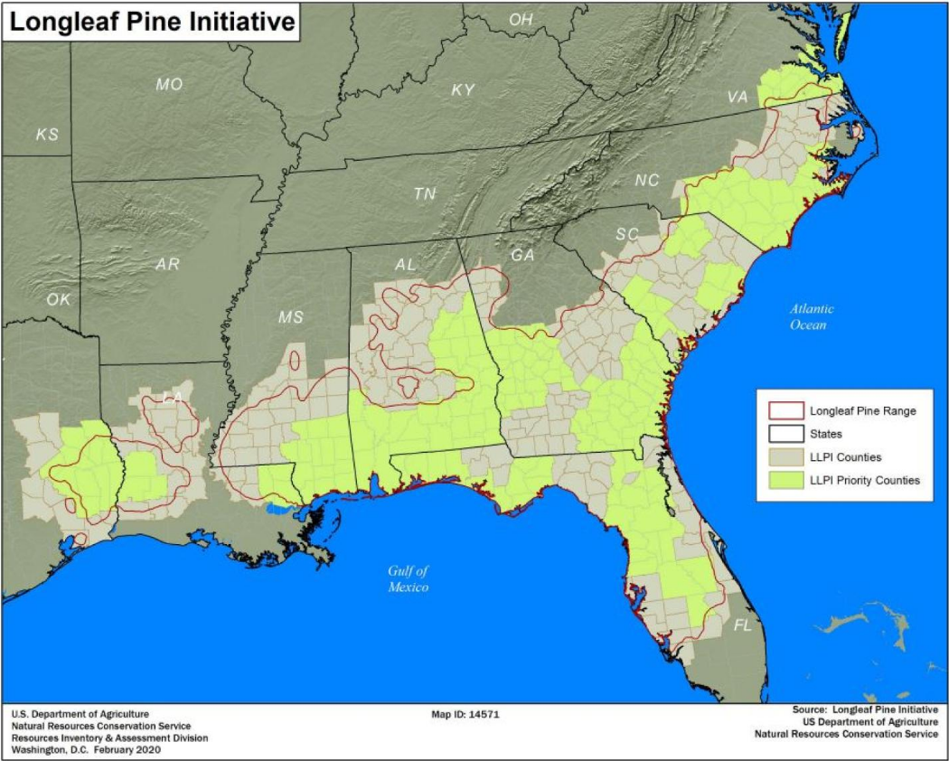
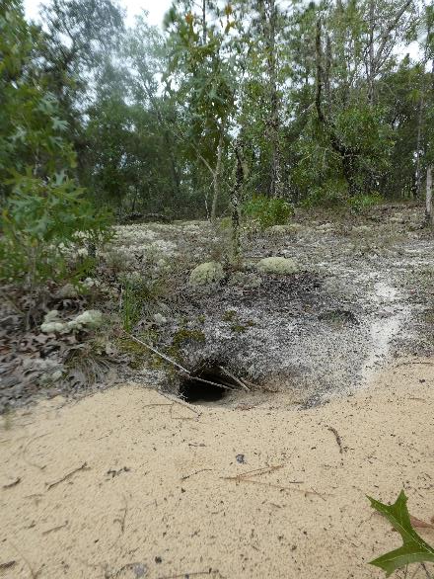
Gopher tortoise (Gopherus polyphemus)
Needs dry upland sandy longleaf pine habitat and a warm subtropical climate.

Slide 16
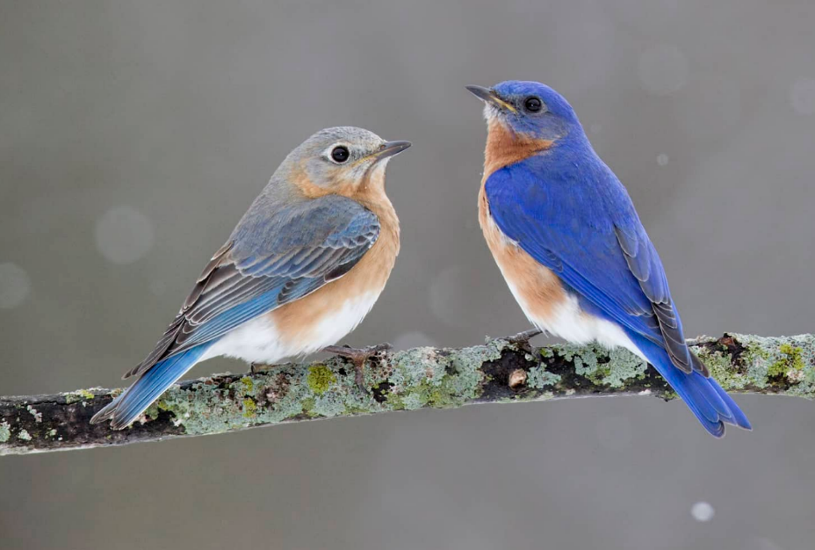
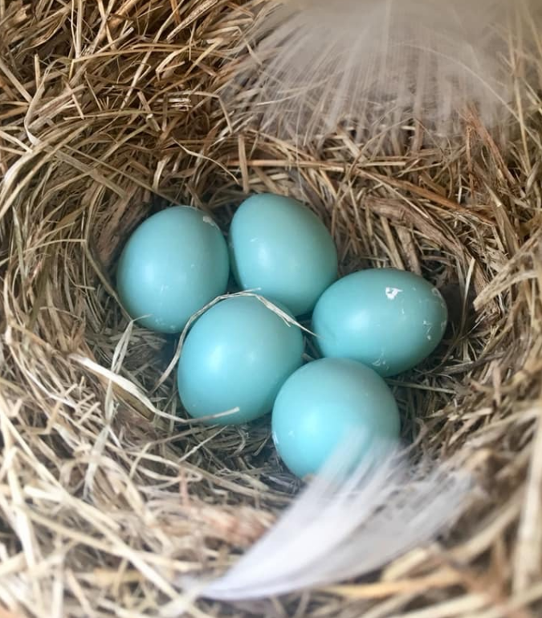
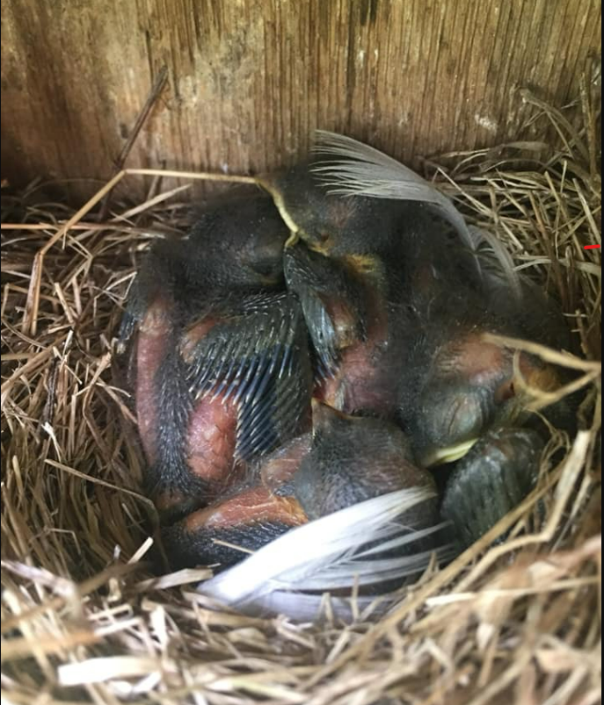
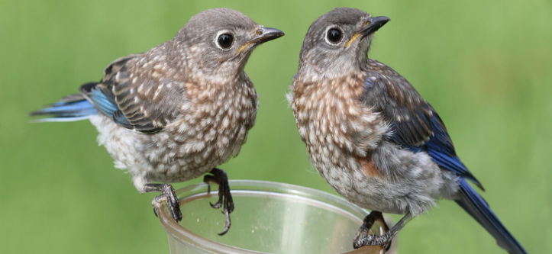
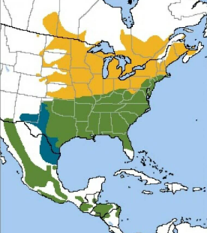
Eastern Bluebird (Sialia sialis) L 7” (18cm) is a “secondary” cavity nester as it cannot excavate its own nest holes in wood. Female & male are noticeably different. Males are more brightly or elaborately colored.
Breeding season is from spring to summer
when there is insect food for the growing nestlings and fledgelings. There are 8 varieties throughout North and Central America. Found in open woodlands, parks, roadsides and gardens. Population about 20 million & increasing
Upper 3 photos from Huron-Clinton Metroparks.com
Juveniles from Steve Byland, Shutterstock Range map from American Bird Conservancy (ABC)

Slide 17
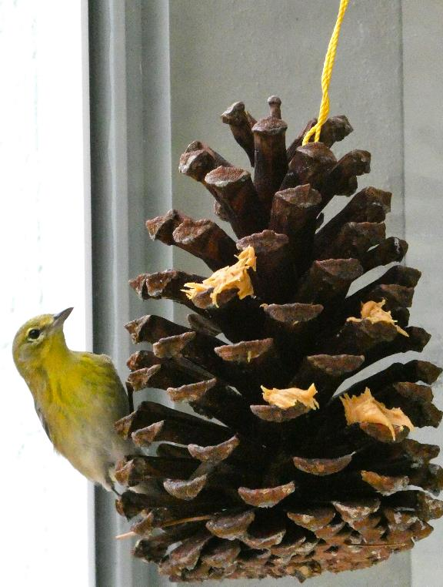
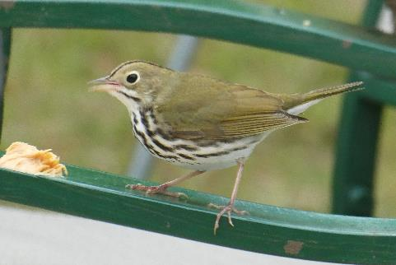
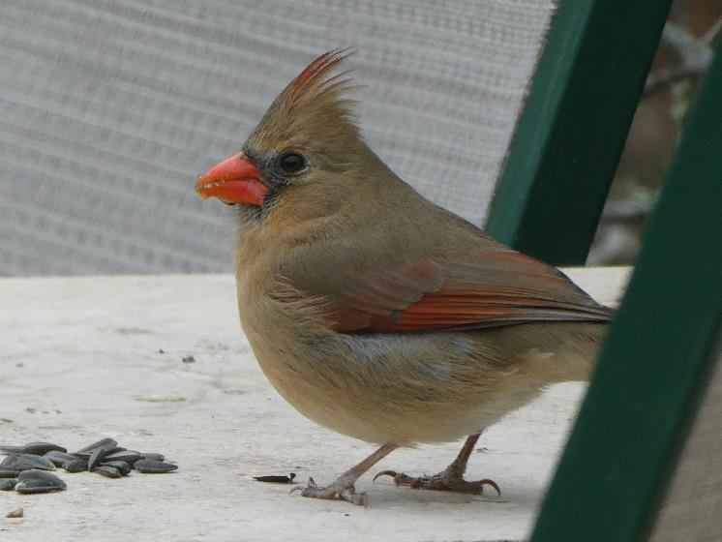
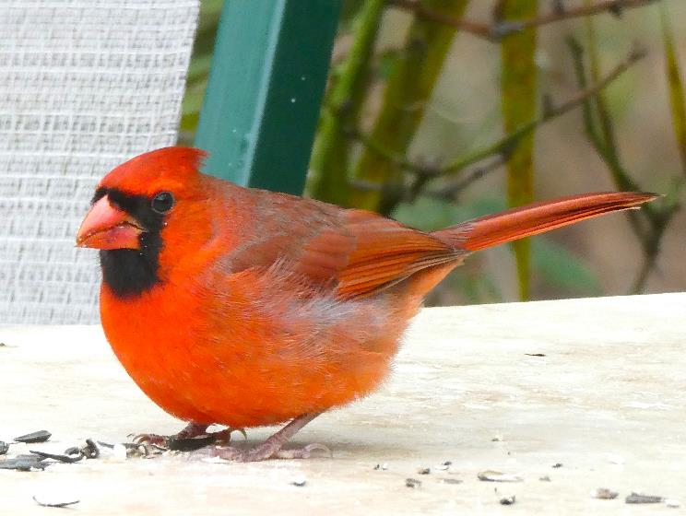
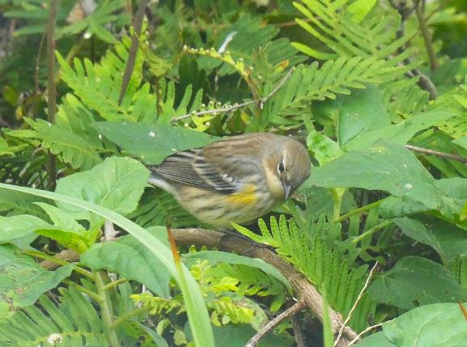
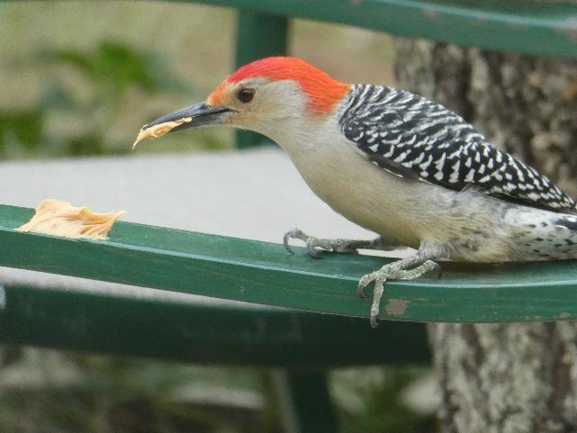
Ovenbird, Seiurus aurocapilla, winter migrant
Northern Cardinal Cardinalis cardinalis female
Backyard Bird feeding
Provide a naturalistic habitat with shelter, cover, nest sites, water and ample food.
Winter feeding: provide black oil sunflower seeds & peanut butter
Woodpecker, Red Bellied Melanerpes carolinus male crown & nape red
Northern Cardinal, Cardinalis cardinalis, male

Slide 18
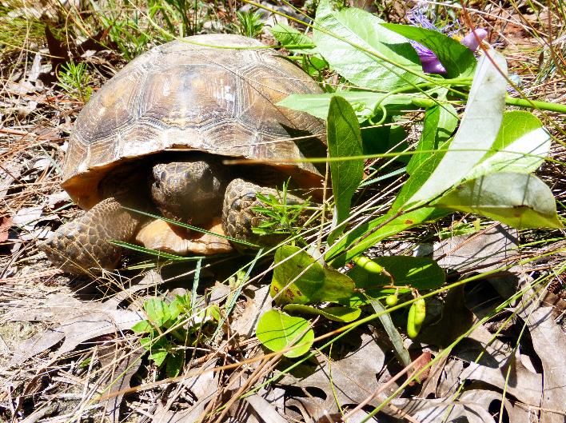
Gopher tortoise (Gopherus polyphemus)
Range: dry, sandy, longleaf pine forest and savannahs in the Southeastern Coastal Plain SE Louisiana Mississippi, Alabama, Georgia, southern South Carolina and n parts of all 67 Florida counties
USDA’s Natural Resources Conservation Service (NRCS)
Status: federally threatened W of Mobile, AL. Protected in all 5 states, Food: leaves, fruit, flowers, broadleaf grasses, wiregrass, prickly pear, wild grape, blackberry, blueberry… Forages within 160’ of burrow Burrows average from 20’ to 40’ long and 6-feet deep
Gopher Apple (Geobalanus oblongifolius).
Range map from USDA’s NRCS Natural Resources Conservation Service

Slide 19
Lepidoptera, butterflies & moths, are cold blooded animal insects with scale-covered wings, 6 legs, 2 antennae, are either female or male ± 160,000 moths & ± 17,500 butterfly species on Earth No part of Florida is within tropical latitudes
Florida has a humid subtropical climate
Butterflies in Florida Facts: ± 750 butterfly species in USA ± 200 in Florida >160 breeding species & ± 40 nonbreeding migrants.
Horace's duskywing Erynnis horatius
Monarch Danaus plexippus
Gulf fritillary graulis vanillae
Pipevine Swallowtail Battus philenor,

Slide 20
Heliconius charithonian Zebra Heliconian (Longwing) is Florida’s state butterfly It needs shade, passiflora host plants, night communal roost sites, pollen and nectar sources.
Protein from pollen makes this species long lived - up to several months. Sexes are similar. Aerial parts of passiflora vines produce cyanide when damaged.

Slide 21
Passiflora manmade hybrid passionvine ‘Insence’
Heliconius charithonian Zebra heliconia (Longwing) is Florida’s state butterfly

Slide 22
Passionflower or Passionvine #32: Passiflora ‘Incense’ #3
Passiflora incarnata X Passiflora cincinnata. Family Passifloraceae
Passiflora incense was developed at the Sub-tropical Horticulture Research Station of the United States Dept. Of Agriculture (USDA) in Miami, Florida, USA. Released to the public in 1973.
This Passionflower was the result of a breeding program that experimented to extend the cold-hardiness range of tropical fruits and was primarily raised to test its fruiting potential. Passiflora incense can yield fruit. It does not have the qualities essential for commercial production.
A deciduous hardy vine, a prolific bloomer and an inedible fruit usually non-viable seed. Host plant for Zebra heliconian and Gulf- & Variegated Fritillary butterfly caterpillars.
From The Ghosh Grove, Rockledge, Florida, USA.
red passionvines, Passiflora vitifolia and P. coccinnea are cyanogenic and native to South America, photo by Judy Boyd
Passiflora incarnata X Passiflora cincinnata rarely produces fruit with viable seed
4-5 leaflets
Passiflora incarnata
Native has 3 parted leaves

Slide 23
Danaus gilippus Queen
Family: Nymphalidae
Brush-foot Milkweed butterfly
Color: orange with black wing borders small white forewing spots
Wingspan: 3-3.5” (7.6-8.9 cm) Sexes: similar but male has black scent patch on hindwings
Host Plants: Milkweed family, White Vine, Sand Vine
Habitat: gardens, pastures, roadsides, pinelands, fields
Range: resident throughout Florida. multiple generations
Jane Weber
Jane Weber
Monarch
2 sets of
antennae
Range map from butterflyidentification.com
Queen caterpillar has
Three sets of antennae
Kristin Schlegel

Slide 24
Danaus plexippus Northern Monarch
Family: Nymphalidae = Brush-foot, Milkweed butterfly
Color: orange, black veins, black wingtips with large white dots trailing edge borders have 2 rows of white spots
Wingspan: 3.5-4” (8.9-10.2 cm) Sexes: similar, males have scent patch on hindwings
Host Plants: Milkweed family, White Vine
Range: North America (Canada, USA, Mexico) & Hawaii Central America, Caribbean Islands, Bermuda coastal NW South America, Galapagos, spread globally
with introduced tropical milkweed Asclepias curassavica
https://ecologyandevolution.cornell.edu

Slide 25
Northern Monarchs may have spread globally
with introduced tropical milkweed
Asclepias curassavica
Florida has 21 native milkweed species DO NOT USE THE EXOTIC INTRODUCED
TROPICAL SPECIES
Jane Weber

Slide 26
Danaus plexippus Northern Monarch
Danaus erippus Southern Monarch
North American Migration routes
Range map from Anurag Agrawal blog, 2023 01 Professor of ecology, evolutionary biology and entomology
Author of Monarchs and Milkweeds
2017 Princeton University Press
Professor of
Environmental Studies
at Cornell University
iNaturalist
2022 04
Danaus erippus Southern Monarch
Butterfly range observations .
iNaturalist is a joint venture of California Academy of Sciences and National Geographic Society
Disney owns 73% of Nat Geo shares

Slide 27
Abaeis nicippe Sleepy Orange butterfly male/female comparison by Vitaly Charny, alabama.butterflyatlas.usf.edu

Slide 28
Pleopeltis polypodioides
Resurrection Fern
is a harmless epiphyte or air plant.
It is not a parasite.
It can grow on the ground or on rocks
It reproduces by spores in sporangia.
on the undersides of leaves.
Widespread in the SE USA, Mexico,
Central- and South America,
Caribbean Islands and Africa.
Range map from Researchgate.net
Range map from Wildsouthflorida.com

Slide 29
Female parts
Diagram from Study.com
Male parts
Flowering plants are angiosperms that evolved after gymnosperms and ferns.
Perfect flowers have both male and female sex cells (gametes) that attract each other.
Imperfect flowers lack either the male or female parts.
Seeds develop in ovaries, fruits and/or nuts.

Slide 30
Florida has 11 native palm species. 6 are frost hardy. There are 2500-2600 species globally.
Palms are evergreen, perennial flowering plants
with perfect flowers, fruits and seeds.
Leaves are palmate (fanlike), pinnate (featherlike), or costapalmate (folded fan with a midrib).
Some native palms are butterfly caterpillar host plants.
Silver Saw Palmetto Serenoa repens
Green Saw Palmetto Serenoa repens
Sabal palm Sabal palmetto Fla’s State tree
Sabal palm Sabal palmetto Florida’s State tree
Palmate leaf
Bluestem palmetto Sabal minor flower stalk taller than leaf
Sabal etonia Scrub palmetto, endemic to FL inflorescence under leaf
Nedle Palm Rhapidophylum hystrix
Costapalmate leaf. With midrib

Slide 31
Florida’s 3 native costapalmate, cold hardy palms Sabal palmetto, Sabal Palm Florida’s State Tree Arborescent tree-like form Costapalmate leaves Edible growth bud but removing it kills the tree native, freeze, drought and salt tolerant.
Flowers and fruit for wildlife, pollinators, birds, bats, butterflies and other wildlife.
Host plant for 2 butterfly caterpillar species
Cover and roost for bats in summer
Sabal minor, dwarf bluestem palmetto Native palm no above ground trunk, one leaf tall
Inflorescence taller than leaves
Host plant for 2 butterfly caterpillars Sabal etonia, Scrub palmetto Endemic to central Florida only
No above ground trunk. Costapalmate leaf Inflorescence under & shorter than leaves.
Host for 2 Florida caterpillar species

Slide 32
Serenoa repens Green Saw Palmetto
Native, freeze tolerant, drought tolerant
Attracts pollinators, birds and other wildlife

Slide 33
Serenoa repens, Silver Saw Palmetto Florida native palmate cluster palm white flowers attract pollinators, birds & wildlife
Butterfly caterpillar host plant Cold hardy, drought & freze tolerant No freeze damage after 20 degrees F

Slide 34
Rhapidophylum histrix Needle Palm evergreen, dwarf, native, freeze tolerant
Palmate leaves, cluster palm
Will develop a trunk in time accents a front porch pillar Sabal palmetto, Sabal palm FL state tree a shades the corner of the roof

Slide 35
Nonnative introduced exotic arborescent palms
Frost hardy in 9a but not freeze tolerant
Phoenix canariensis Canary Island Date Palm not native, not freeze tolerant
CID is a flowering plant with perfect flowers but will not set fruit in subtropical climates

Slide 36
Nonnative introduced exotic arborescent palms
Frost hardy in 9a but not freeze tolerant
Queen Palm fruit is edible sheds readily eaten by rodents and other wildlife
Can be very messy
when fruit litters the ground
Bismarkia nobilis Silver Bismark Palm not native, not freeze tolerant
Syagrus romanzoffiana Queen Palm pinnate fronds Exotic, introduced not cold hardy north of zone 9a,

Slide 37
Pindo Palm fruit eat fresh; pit and freeze; or make jam, jelly or wine
Butia odorata, Pindo Palm, Pindo Palm
South American, nonnative
edible fruit Cold and drought tolerant

Slide 38
Butagrus nabonnandii, Mule Palm, grown at Brooksville Palms, FL. Manmade hybrid cross between Queen and Pindo palms. more cold tolerant than a Pindo Palm
Pinnate fronds with the gracefulness of a Queen Palm
Edible fruit but the seeds inside are generally sterile.
Makes good jam, jelly and wine

Slide 39
Nonnative introduced exotic dwarf palms
Frost hardy but not freeze tolerant
Phoenix robilini Pygmy Date Palm
Not native from S Asia
Not freeze tolerant
Raphis excelsa (Chinese) Lady Palm Not native from S Asia
Not freeze tolerant

Slide 40
Ilex yaupon is a native, evergreen, perennial tree or shrub, endemic to the SE Coastal Plain. A flowering plant, it has incomplete flowers: plants are either male or female (dioaceious). In 1753 Carl Linnaeus, in his work “Species Plantarum”, named the yaupon tea plant Ilex cassine Var.β. In 1789 William Aiton, Scottish botanist at Kew Gardens, London, published “Hortus Kewensis” coining the erroneous Latinized name Ilex vomitoria. It comes from tales by Europeans that the plant caused vomiting in certain ceremonies. At the time, the British East India Company wanted to discourage the use of yaupon tea for economic and political reasons as they were major importers of Chinese tea, (Camellia sinensis), used in China for about 5,000 years. Coffee (Coffea arabica) has been used for about 600 years. Ilex Yaupon tea “Black Drink” has been used by indigenous peoples for 14,000 years.
Ilex Yaupon tea is made from tiny dried leaves
Weeping Yaupon holly, female
Ilex vomitoria
Weeping Yaupon holly female
Ilex Yaupon holly male

Slide 41
Ilex vomitoria
Weeping Yaupon holly female
Ilex Yaupon holly male

Slide 42
Ilex Yaupon tea (Ilex vomitoria), endemic to the USA’s Southeastern Coastal Plain,
has been used as a healthy caffeinated beverage for about 14,000 years.
One of the first agricultural crops to be exported by colonists to Europe.
Active ingredients in Ilex Yaupon tea are caffeine and the methylxanthine alkaloids theobromine and theophylline which are biomarkers for several Ilex species. Dried yaupon leaves have at least 4 natural polyphenol antioxidants, ursolic acid and vitamins as does South America’s Yerba Mate (Ilex paraguensis) and Guayusa (Ilex guayusa) from Amazonia.

Slide 43
Callicarpa americana American Beauty Berry deciduous native shrub

Slide 44
Hydrangea quercifolia oakleaf hydrangea FL native deciduous flowering shrub

Slide 45
Myrcianthes fragrans, Simpson's Stopper native evergreen large shrub or small tree under 30 ft tall small white spring flowers, edible orange fruit
Attracts pollinators, birds, bees, butterflies and more

Slide 46
Hamelia patens, Firebush native, perennial, frost-tender shrub to non-woody small tree Nectar-rich tubular flowers attract butterflies and hummingbirds.
Fruit and seeds feed wildlife

Slide 47
Hamelia patens, Firebush, native, perennial frost-tender shrub to small non-woody tree. Nectar-rich tubular flowers attract, insects pollinators, butterflies and hummingbirds.
Pipevine Swallowtail, Battus philenor mating on Firebush, Hamelia patens
Giant Swallowtail Dan Reick

Slide 48
Berlandiera subacaulis
Greeneyes
Is a native, perennial, evergreen wildflower with basal leaves.
Endemic to central Florida
Zones 8-11. Deep tap root
Drought tolerant. Frost hardy
Perfect flower with male stamens with male sex gametes and female pistils with female sex cells to produce seeds. Ray & disk florets

Slide 49
Helianthus sunflowers are native wildflowers rich in nectar & pollen
Helianthus debilis →
Beach- or Dune Sunflower
Thrives in well-drained, sandy soil and full sun. Is native, annual, sprawling, self-seeding, drought tolerant, frost tender and an excellent nectar and pollen source.
Helianthus angustifolia
Narrow-leaf sunflower is a tall native, perennial, deciduous (dormant in winter), frost hardy species that needs moist to wet soil and full sun. ↓ ↓

Slide 50
Potted native plants available
at Jane’s garden
$1 per year, plus tax & handling
Seed envelopes $1 (no tax in FL)
Fresh seeds harvested
in season at Jane’s Garden

Slide 51
Jane Weber: author, conservationist, gardener, environmentalist, tea grower, traveler, writer…
352 249 6899 jweber12385@gmail.com Facebook.com/janeweber.3939

