Slide 1
The birds and the bees, the flowers and the trees and the moon up above… all involve
Sex in the Garden
Withlacoochee Gulf Preserve 2024 01 30, 10:00
Assembled by Jane Weber: author, conservationist, gardener, environmentalist, traveler, writer…

Slide 2
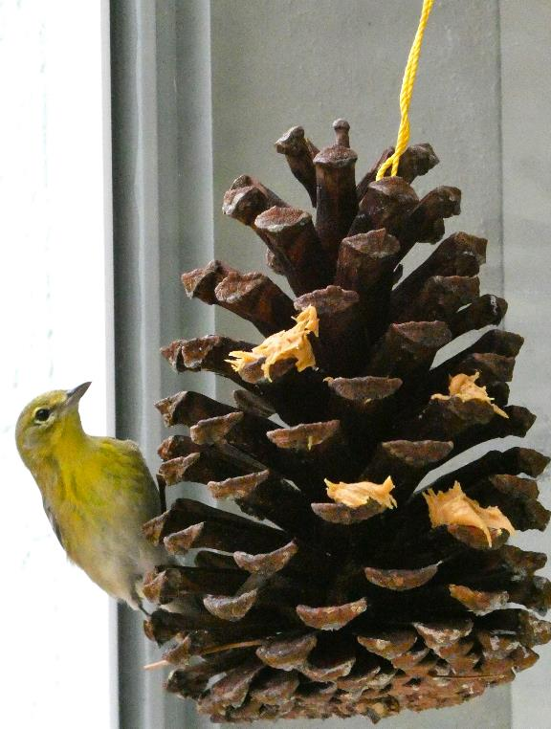
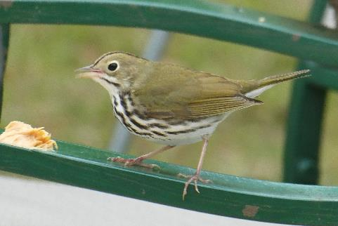
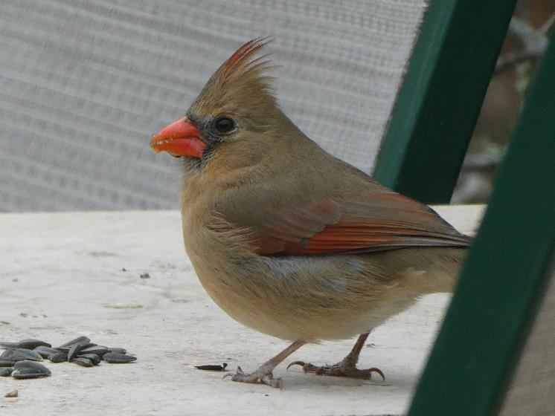
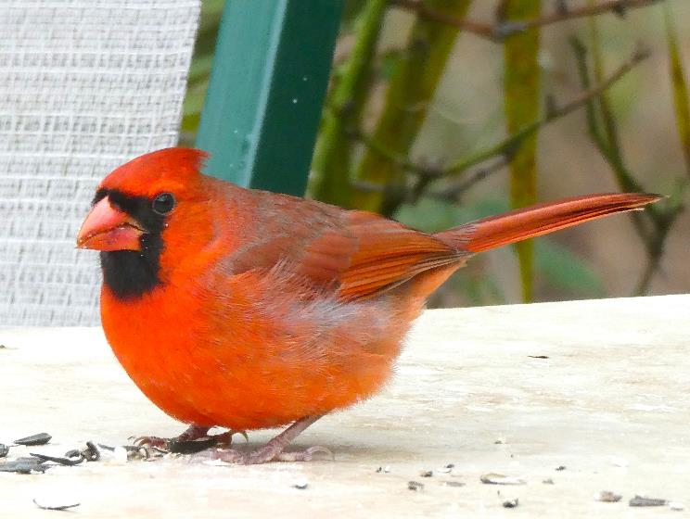
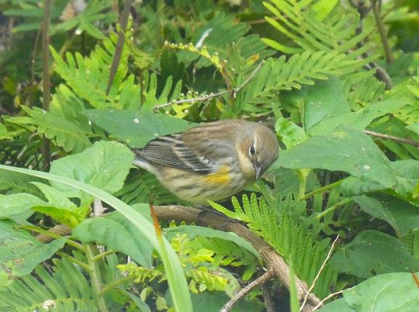
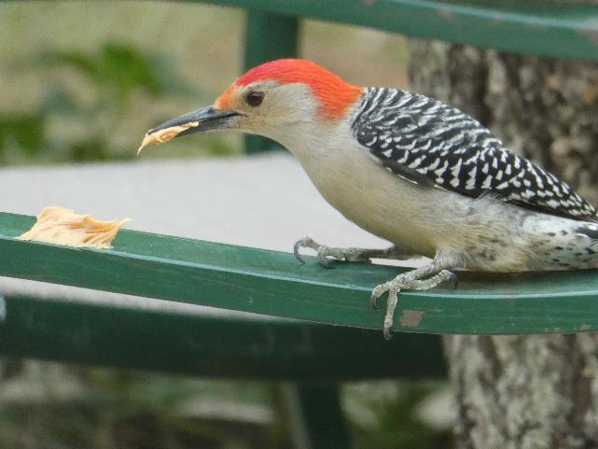
Ovenbird, Seiurus aurocapilla, winter migrant
Northern Cardinal Cardinalis cardinalis female
Backyard Bird feeding
Provide a naturalistic habitat with shelter, cover, nest sites, water and ample food.
Winter feeding: provide black oil sunflower seeds & peanut butter
Woodpecker, Red Bellied Melanerpes carolinus male crown & nape red
Northern Cardinal, Cardinalis cardinalis, male

Slide 3
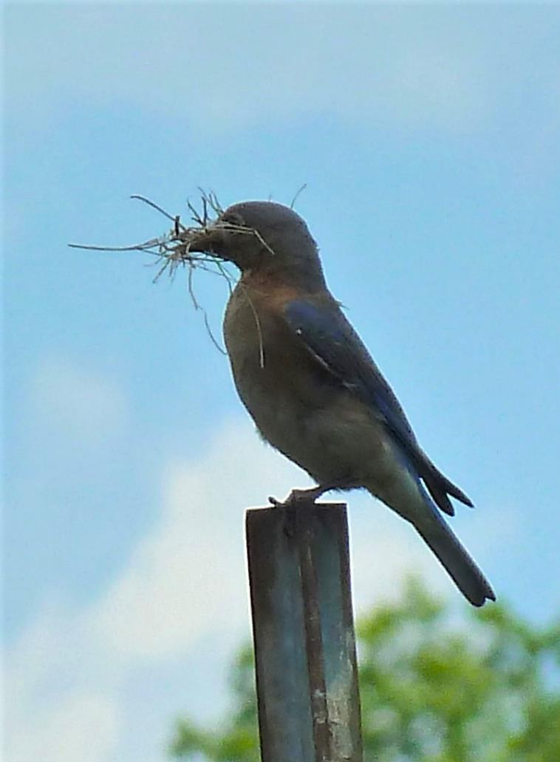
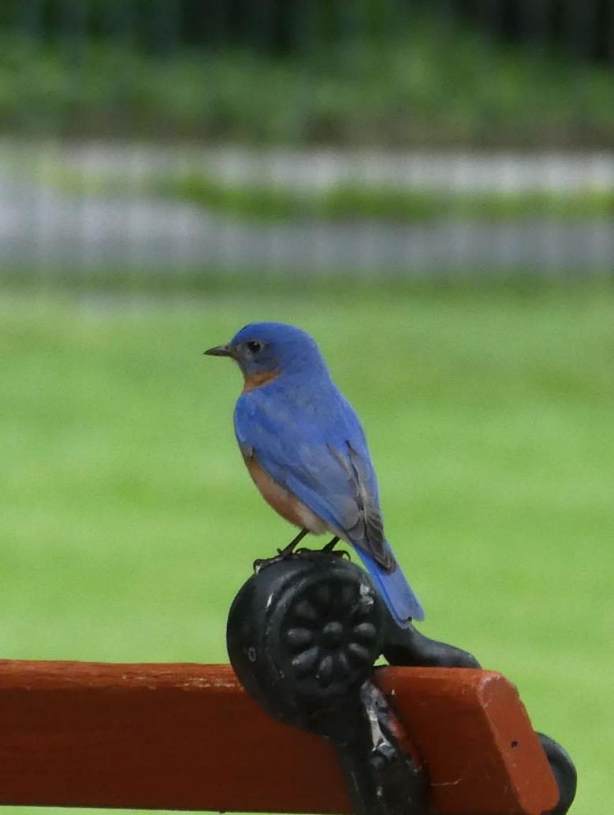

Slide 4
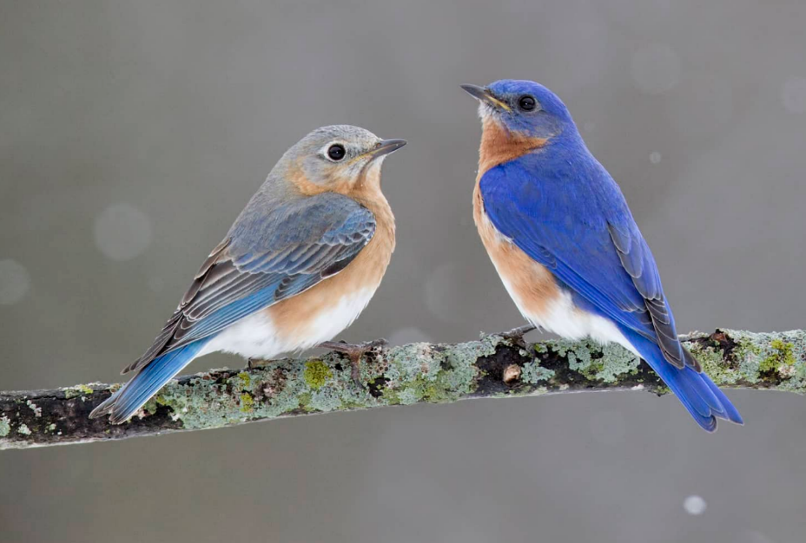
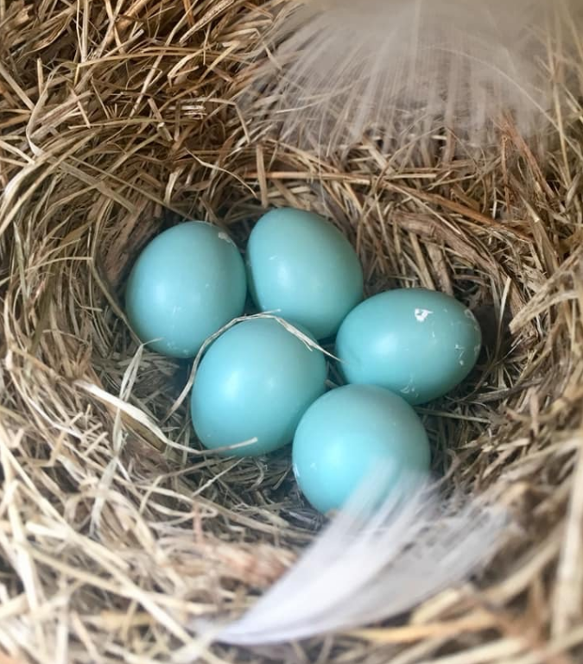
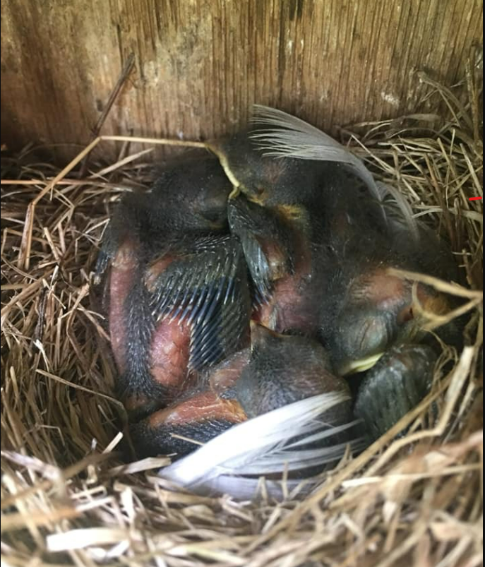
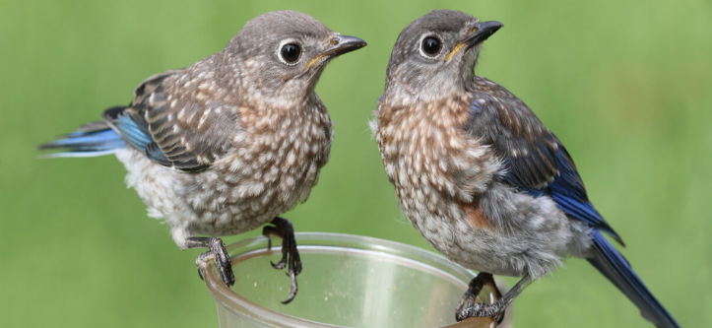
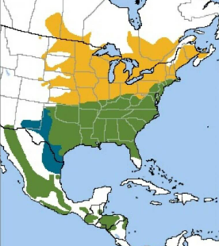
Eastern Bluebird (Sialia sialis) L 7” (18cm) is a “secondary” cavity nester as it cannot excavate its own nest holes in wood. Female & male are noticeably different. Males are more brightly or elaborately colored.
Breeding season is from spring to summer
when there is insect food for the growing nestlings and fledgelings. There are 8 varieties throughout North and Central America. Found in open woodlands, parks, roadsides and gardens. Population about 20 million & increasing
Upper 3 photos from Huron-Clinton Metroparks.com
Juveniles from Steve Byland, Shutterstock Range map from American Bird Conservancy (ABC)

Slide 5
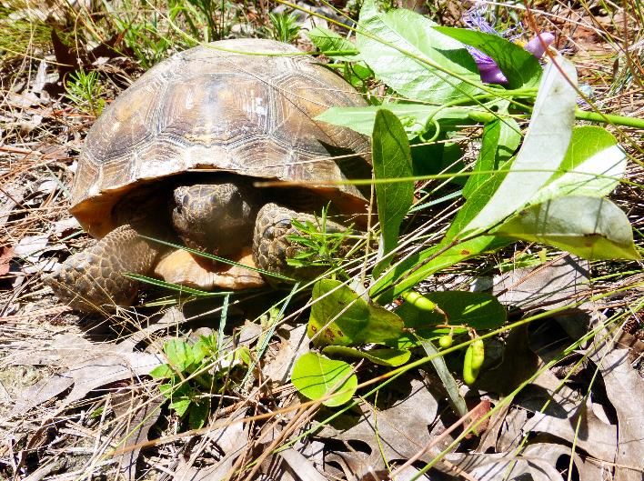
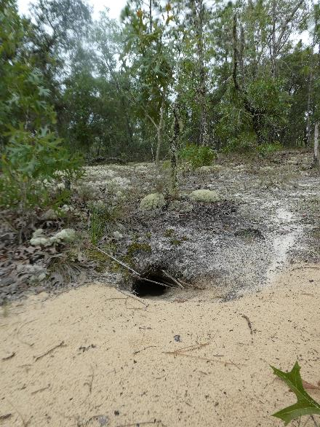
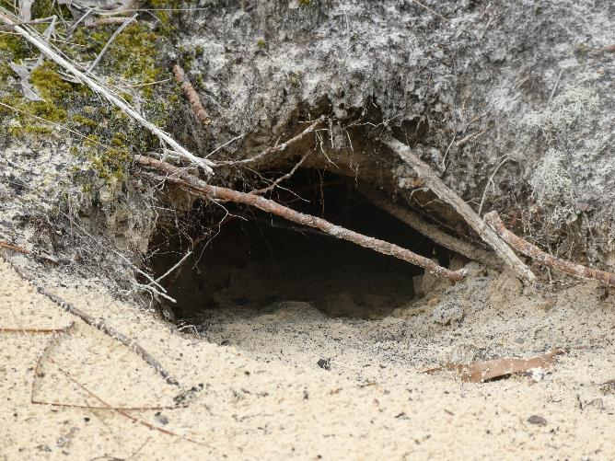
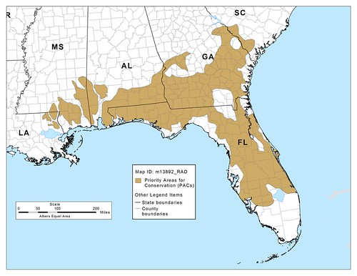
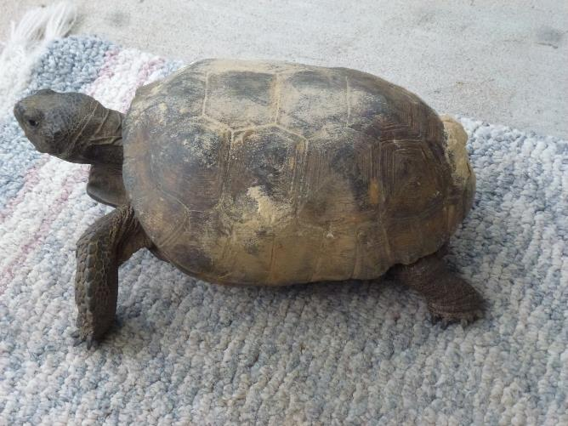
Gopher tortoise (Gopherus polyphemus)
Range: dry, sandy, longleaf pine forest and savannahs in the Southeastern Coastal Plain SE Louisiana Mississippi, Alabama, Georgia, southern South Carolina and n parts of all 67 Florida counties
USDA’s Natural Resources Conservation Service (NRCS)
Status: federally threatened W of Mobile, AL. Protected in all 5 states, Food: leaves, fruit, flowers, broadleaf grasses, wiregrass, prickly pear, wild grape, blackberry, blueberry… Forages within 160’ of burrow Burrows average from 20’ to 40’ long and 6-feet deep
Gopher Apple (Geobalanus oblongifolius).
Range map from USDA’s NRCS Natural Resources Conservation Service

Slide 6
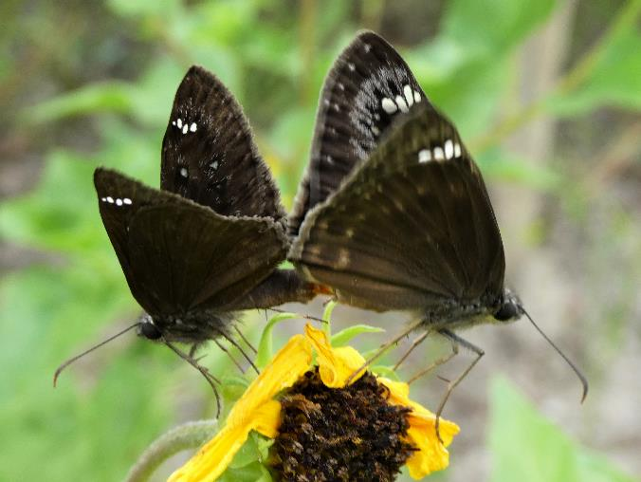
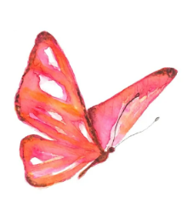
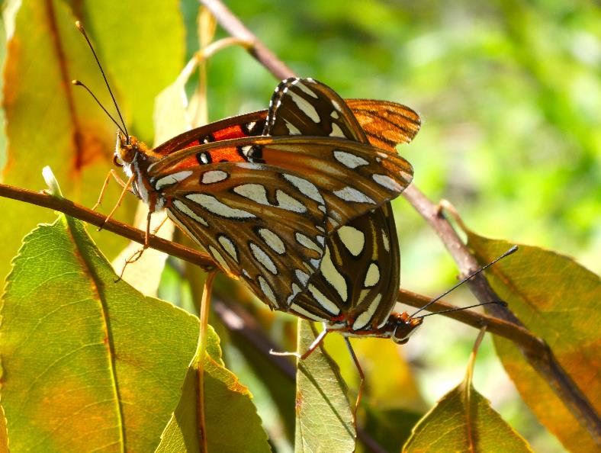
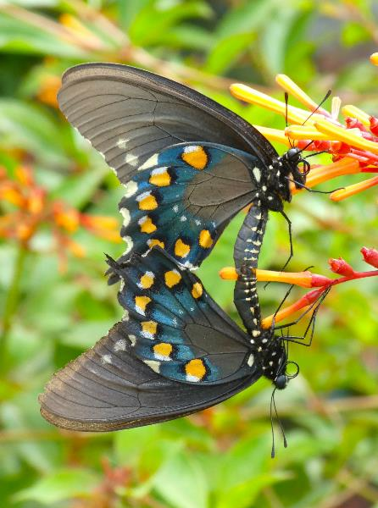
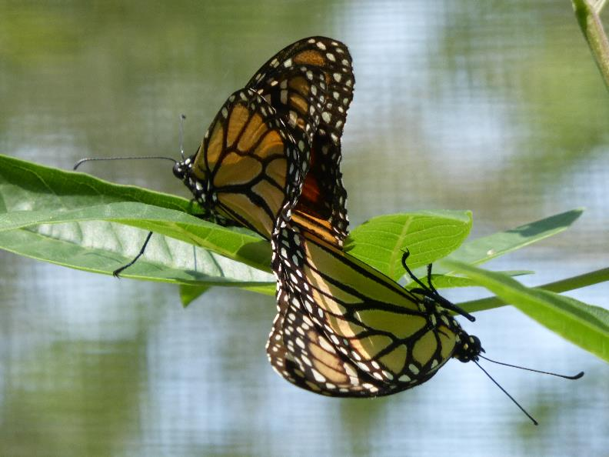
Lepidoptera, butterflies & moths, are cold blooded animal insects with scale-covered wings, 6 legs, 2 antennae, are either female or male ± 160,000 moths & ± 17,500 butterfly species on Earth No part of Florida is within tropical latitudes
Florida has a humid subtropical climate
Butterflies in Florida Facts: ± 750 butterfly species in USA ± 200 in Florida >160 breeding species & ± 40 nonbreeding migrants.
Horace's duskywing Erynnis horatius
Monarch Danaus plexippus
Gulf fritillary graulis vanillae
Pipevine Swallowtail Battus philenor,

Slide 7
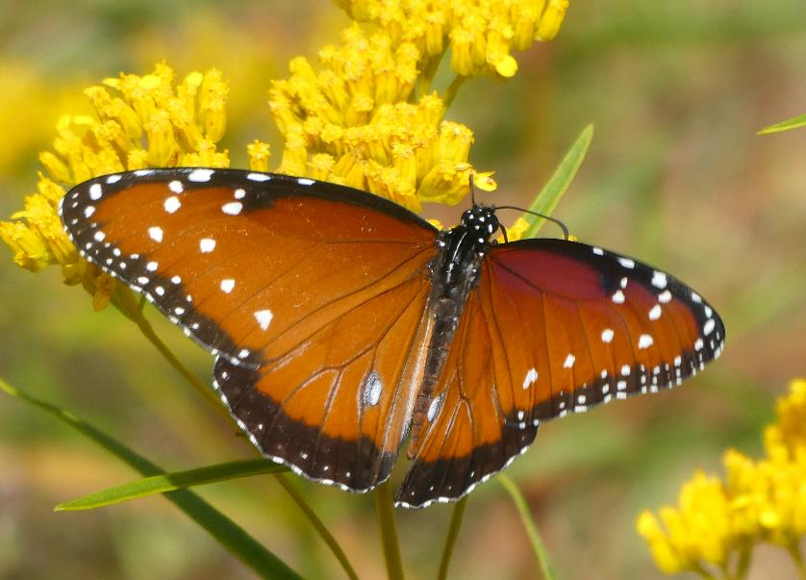
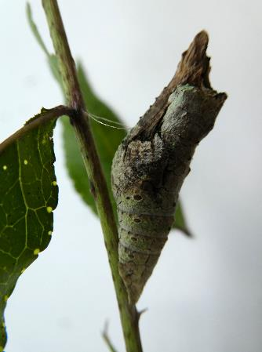
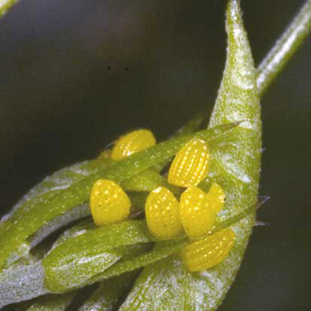
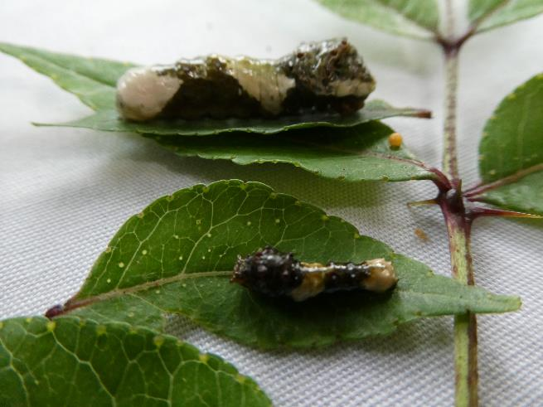
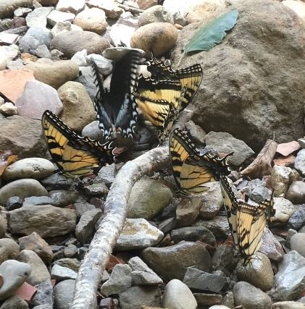
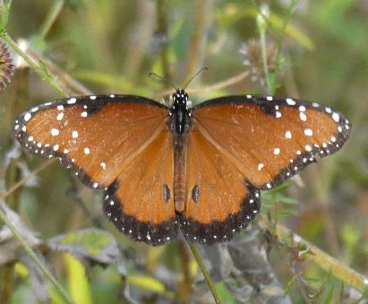
A butterfly garden must have: 1 specific host plants for eggs & caterpillars
2 shelter from predators and the weather 3 Safe, concealed places for pupae 4 nectar, pollen, water, & food sources for adults
5 Adult male & female butterflies often puddle in damp soils to get salts & minerals.
6 Some adult butterflies need over-ripe fruit, fresh dung, tree sap, &/or animal remains.
Queen, Danaus gilippus, male
Herculides cresphontes Giant Swallowtail

Slide 8
Britannica.com 2023 11 24
Gymnosperm, any vascular plant that reproduces by means of an exposed seed,
—unlike angiosperms, or flowering plants, whose seeds are enclosed by mature ovaries or fruits.
The seeds of many gymnosperms (literally, “naked seeds”) are borne in female cones and are not visible until maturity.
Taxonomists recognize four distinct divisions of extant (nonextinct, living) gymnospermous plants
— Pinophyta, Cycadophyta, Ginkgophyta, and Gnetophyta —
with 88 genera and more than 1,000 species distributed throughout the world.
Gymnosperms were dominant in the Mesozoic Era (about 252.2 million to 66 million years ago),
during which time some of the modern families originated (Pinaceae, Araucariaceae, Cupressaceae).
Wikipedia 2023 08
“Ferns first appear in the fossil record about 360 million years ago in the
late Devonian period (419.2 to 358.9 million years ago) (MYA)
but Polypodiales, the group that makes up 80% of living fern diversity,
did not appear and diversify until the Cretaceous (145 – 66 MYA)
contemporaneous with the rise of flowering plants that came to dominate the world's flora.”
nps.gov 2023 04 27 National Park Service (NPS) Cretaceous Period 145 - 66 MYA Angiosperms (flowering plants) appeared in the fossil record more than 100 MYA during the Cretaceous.
Once they appeared, they quickly became the dominant type of plant life on land and remain so today.
The earliest angiosperms evolved from a specialized group of seed ferns.

Slide 9
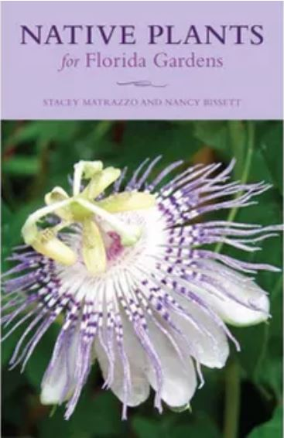
2003 2005 2019 2020 2021
Older books are a wealth of information but are accurate only up to the date of publication.
Check online, from a reliable source, for up-to-date scientific names, new scientific research... Reliable, up-to-date sites include Encyclopedia Britannica, Alabama.butterflyatlas.usf.edu, Cornell.edu. UF, Butterfliesandmoths.org, iNaturalist, Wikipedia and other updated sources.
2017

Slide 10
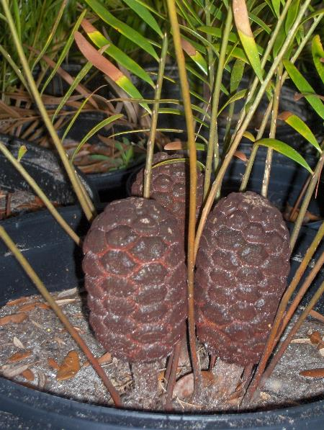
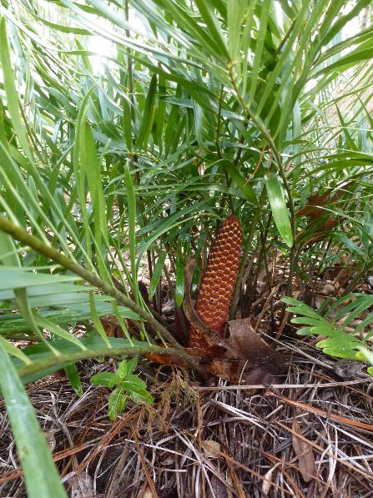
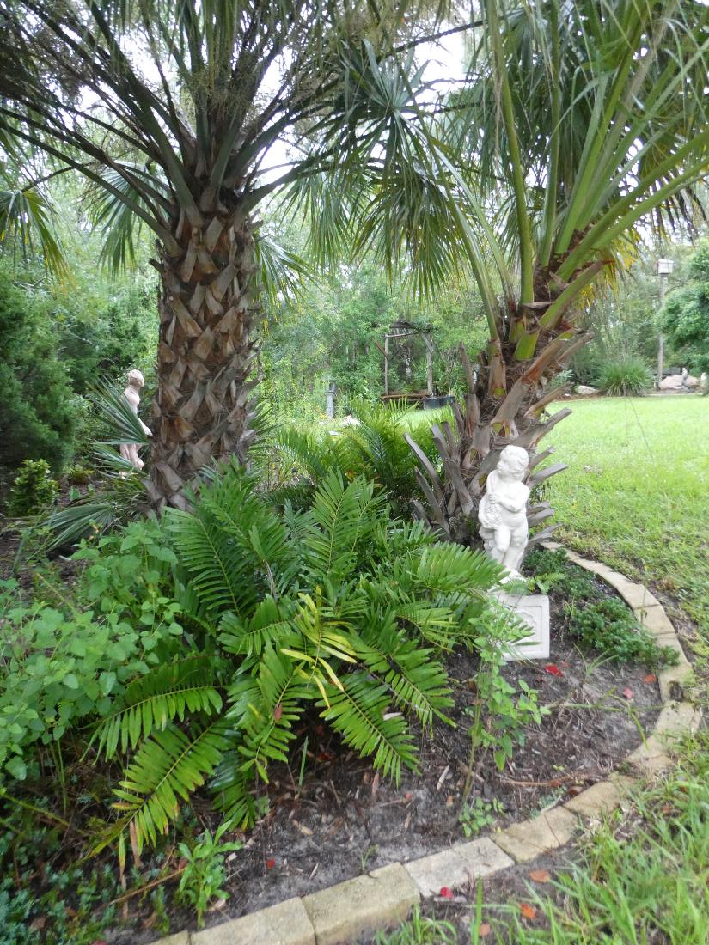
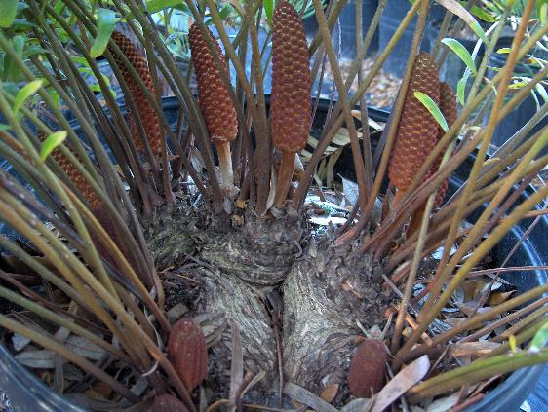
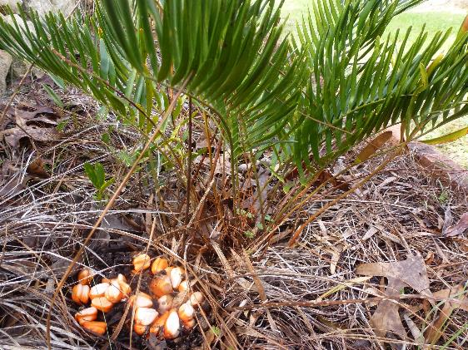
Zamia integrifolia, Coontie is a cycad gymnosperm NOT A PALM

Slide 11
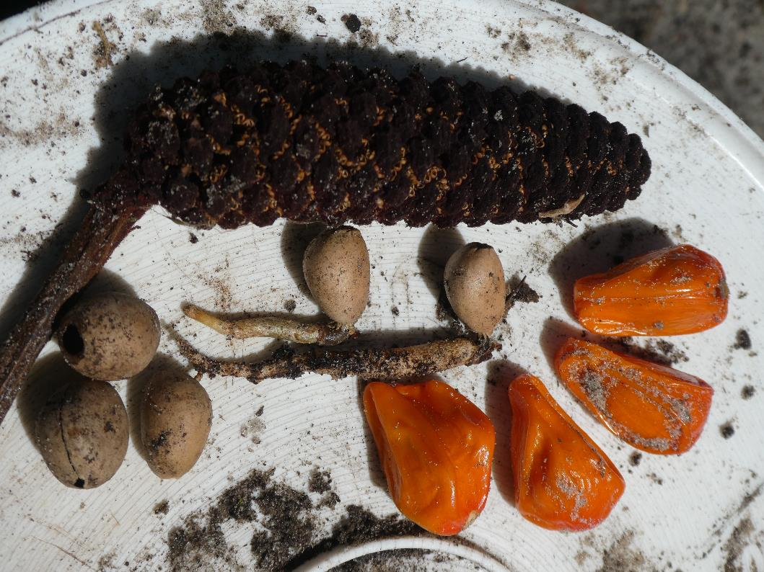
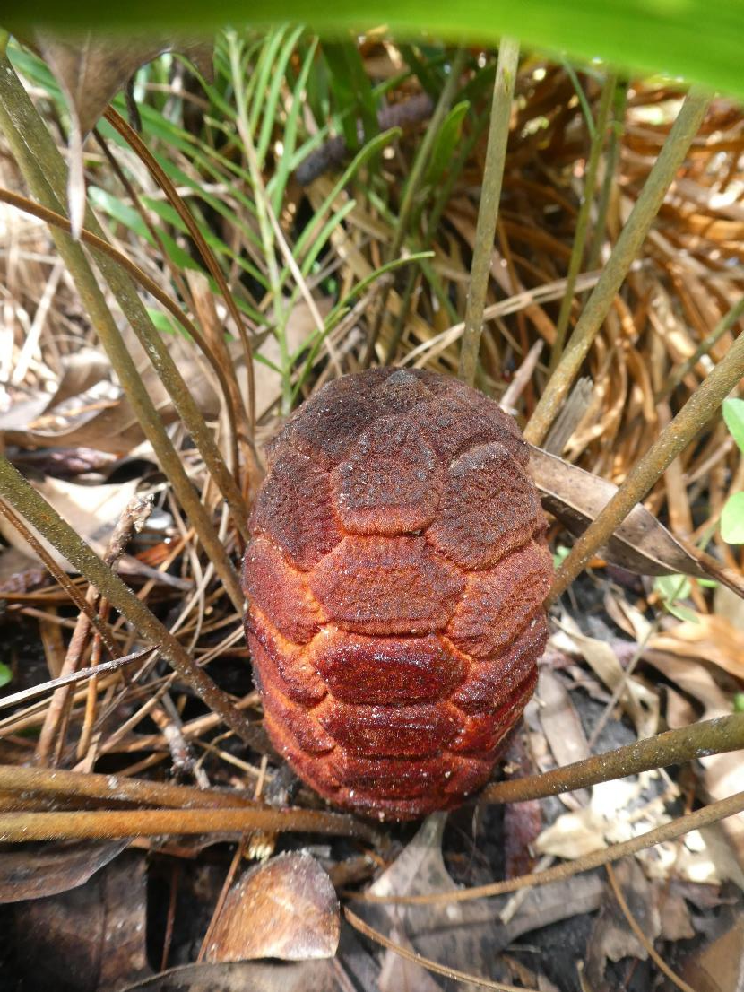
Zamia integrifolia, Coontie is a cycad.
1 spent male cone.
2 sprouted seeds.
3 predated empty seed shells.
4 fresh seeds with germination inhibitor in the sarcotesta.

Slide 12
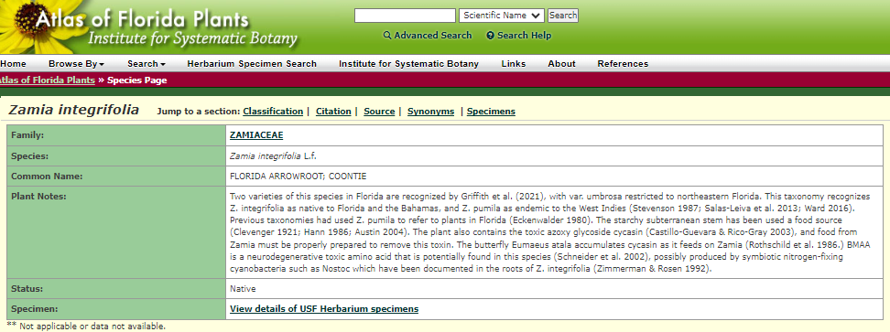
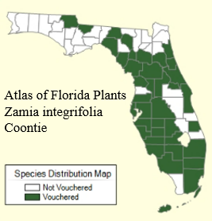
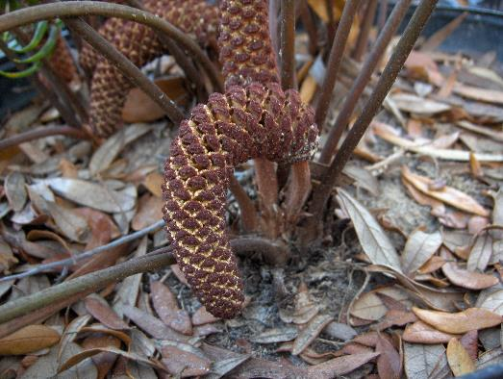
Two varieties of this species in Florida - Griffith et al. (2021), with Z. integrifolia var. umbrosa restricted to northeast Florida. This taxonomy recognizes Zamia integrifolia as native to Florida and the Bahamas, and Z. pumila as endemic to the West Indies
Atlas of Florida Plants Zamia integrifolia, Coontie

Slide 13
Wikipedia:
“Like other cycads, Zamia integrifolia is poisonous, producing a (neuro)toxin that affects the gastrointestinal tract and nervous system. The toxin can however be removed by careful leaching, and the roots and half-buried stems of this cycad were used by Native American people (notably the Tequesta and Mayaimi Indians, the Seminole Indians and the Maroons) to produce this starch. The root is typically prepared by grinding (macerating) it using a wooden mortar and pestle. The pulp is then saturated in water and drained. The drained fluid is allowed to dry, and the resulting yellowish powder is used in the preparation of various foods.
In commercial production, multiple macerations achieved a whiter color.
Commercial production of the starch (using roots gathered from wild plants) occurred in South Florida, from the 1830s until the 1920s.
(Zamia integrifolia Coontie) starch was sold as Florida arrowroot until the Food and Drug Administration banned the practice in 1925. The last commercial "coontie starch" factory in Florida was destroyed by the 1926 Miami Hurricane.”

Slide 14
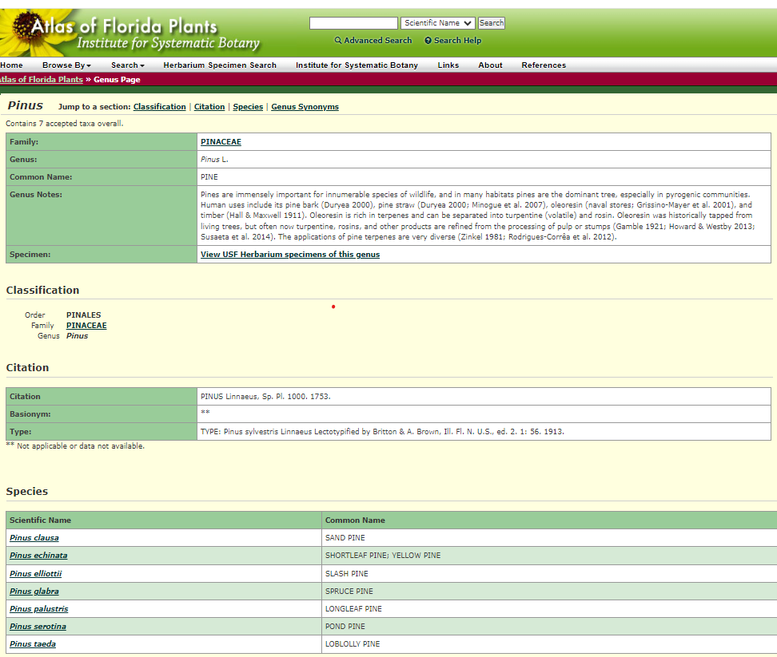
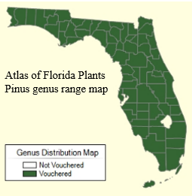
Florida has 7 species of native pine trees
Check their range at the online plant atlas Atlas of Florida Plants
University of South Florida family of PlantAtlas.org websites

Slide 15
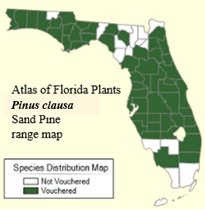
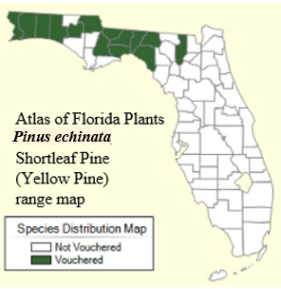
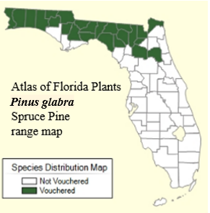
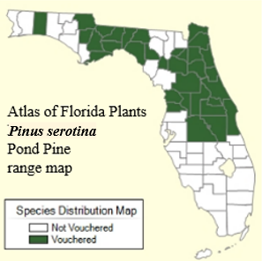
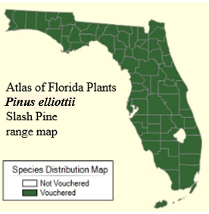
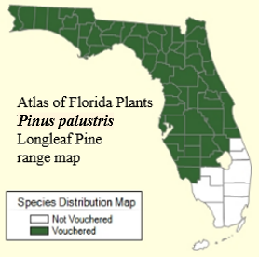
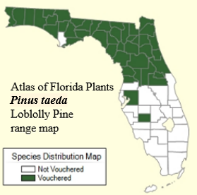
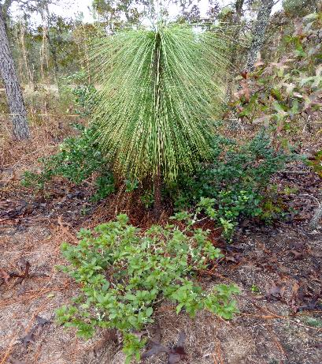
Levy County has 4 species of native pines. Long leaf pine (Pinus palustris)stays in its juvenile grass stage for at least 8 years.
It needs periodic fires to help clear out faster growing Slash Pines (Pinus elliottii)
For more information, contact: Richard Wunderlin or Bruce Hansen, Alan Franck, or Karla Alvarado
© 2024 Institute for Systematic Botany | Data last modified: 1/25/2024 Web Development: USF Water Institute
A member of the University of South Florida family of PlantAtlas.org websites

Slide 16
Gopher tortoise (Gopherus polyphemus)
Needs dry upland sandy longleaf pine habitat and a warm subtropical climate.

Slide 17
Gymnosperms evolved before angiosperm flowering plants. Araucaria, cycad, cypress, fir, ginkgo, juniper, larch, pine, spruce, torreya, etc. are gymnosperms with naked seeds in cones. Florida has 7 species of native perennial evergreen pine trees (Sand, Slash, Longleaf, Loblolly, Pond, Spruce & Shortleaf/Yellow); 2 species of cypress (Pond and Bald); one cycad (Coontie) and one critically endangered Torreya taxifolia.
Pinus taeda
Loblolly cone, female
Taxodium distichum Bald Cypress
lives up to 600 years
Juniperus virginiana
Juniper Redcedar
Juniperus virginiana
Juniper cones, female
Zamia integrifolia
Coontie cone, male

Slide 18
Pinus palustris Longleaf
Out of the grass stage
About 9-10 years old
Pinus palustris Longleaf Pine seeds
Pinus palustris Longleaf Pine
Pinus taeda Loblolly Pine
Pinus clausa Sand Pine
Pinus elliottii Slash Pine
Pinus palustris Longleaf Pine

Slide 19
Pleopeltis polypodioides
Resurrection Fern
is a harmless epiphyte or air plant.
It is not a parasite.
It can grow on the ground or on rocks
It reproduces by spores in sporangia.
on the undersides of leaves.
Widespread in the SE USA, Mexico,
Central- and South America,
Caribbean Islands and Africa.
Range map from Researchgate.net
Range map from Wildsouthflorida.com

Slide 20
Female parts
Diagram from Study.com
Male parts
Flowering plants are angiosperms that evolved after gymnosperms and ferns.
Perfect flowers have both male and female sex cells (gametes) that attract each other.
Imperfect flowers lack either the male or female parts.
Seeds develop in ovaries, fruits and/or nuts.

Slide 21
Lepidoptera is an order of insects that includes butterflies and moths
(both are called lepidopterans)
Lepidoptera order is about 10 percent of the total described species of living organisms One of the most widespread and widely recognizable insect orders in the world
About 180,000 species of the Lepidoptera are described, in 126 families and 46 superfamilies
There are about 17,500 butterfly species and some 160,000 moth species on Earth
Adult butterflies are 6-legged insects familiar to gardeners and humans globally.
Butterflies generally have bright colors and visit flowers for nectar and pollen during the day.
Moths and butterflies have scales (modified, flattened "hairs“) that cover bodies, & wings,
and a proboscis. Scales give lepidopterans a wide variety of colors and patterns.
The continental USA has about 750 butterfly species.
Florida has almost 200 butterfly species, depending on latitude, location and habitat.
About 160 are breeding resident species and about 40 are rare, vagrant or migratory.

Slide 22
A butterfly garden must have: 1 specific host plants for eggs & caterpillars
2 shelter from predators and the weather 3 Safe, concealed places for pupae 4 nectar, pollen, water, & food sources for adults 5 Adult male & female butterflies often puddle in damp soils to get salts & minerals. 6 Some adult butterflies need over-ripe fruit, fresh dung, tree sap, &/or animal remains.
Danaus gilippus Queen, male
Euptoieta claudia Variegated Fritillary
Milkweed Asclepias spp.
Herculides cresphontes Giant Swallowtail
.

Slide 23
Heliconius charithonian Zebra Heliconian (Longwing) is Florida’s state butterfly It needs shade, passiflora host plants, night communal roost sites, pollen and nectar sources.
Protein from pollen makes this species long lived - up to several months. Sexes are similar. Aerial parts of passiflora vines produce cyanide when damaged.

Slide 24
Passiflora manmade hybrid passionvine ‘Insence’
Heliconius charithonian Zebra heliconia (Longwing) is Florida’s state butterfly

Slide 25
Passionflower or Passionvine #32: Passiflora ‘Incense’ #3
Passiflora incarnata X Passiflora cincinnata. Family Passifloraceae
Passiflora incense was developed at the Sub-tropical Horticulture Research Station of the United States Dept. Of Agriculture (USDA) in Miami, Florida, USA. Released to the public in 1973.
This Passionflower was the result of a breeding program that experimented to extend the cold-hardiness range of tropical fruits and was primarily raised to test its fruiting potential. Passiflora incense can yield fruit. It does not have the qualities essential for commercial production.
A deciduous hardy vine, a prolific bloomer and an inedible fruit usually non-viable seed. Host plant for Zebra heliconian and Gulf- & Variegated Fritillary butterfly caterpillars.
From The Ghosh Grove, Rockledge, Florida, USA.
red passionvines, Passiflora vitifolia and P. coccinnea are cyanogenic and native to South America, photo by Judy Boyd
Passiflora incarnata X Passiflora cincinnata rarely produces fruit with viable seed
4-5 leaflets
Passiflora incarnata
Native has 3 parted leaves

Slide 26
Danaus gilippus Queen
Family: Nymphalidae
Brush-foot Milkweed butterfly
Color: orange with black wing borders small white forewing spots
Wingspan: 3-3.5” (7.6-8.9 cm) Sexes: similar but male has black scent patch on hindwings
Host Plants: Milkweed family, White Vine, Sand Vine
Habitat: gardens, pastures, roadsides, pinelands, fields
Range: resident throughout Florida. multiple generations
Jane Weber
Jane Weber
Monarch
2 sets of
antennae
Range map from butterflyidentification.com
Queen caterpillar has
Three sets of antennae
Kristin Schlegel

Slide 27
Danaus plexippus Northern Monarch
Family: Nymphalidae = Brush-foot, Milkweed butterfly
Color: orange, black veins, black wingtips with large white dots trailing edge borders have 2 rows of white spots
Wingspan: 3.5-4” (8.9-10.2 cm) Sexes: similar, males have scent patch on hindwings
Host Plants: Milkweed family, White Vine
Range: North America (Canada, USA, Mexico) & Hawaii Central America, Caribbean Islands, Bermuda coastal NW South America, Galapagos, spread globally
with introduced tropical milkweed Asclepias curassavica
https://ecologyandevolution.cornell.edu

Slide 28
Northern Monarchs may have spread globally
with introduced tropical milkweed
Asclepias curassavica
Florida has 21 native milkweed species DO NOT USE THE EXOTIC INTRODUCED
TROPICAL SPECIES
Jane Weber

Slide 29
Danaus plexippus Northern Monarch
Danaus erippus Southern Monarch
Range map from Anurag Agrawal blog, 2023 01 Professor of ecology, evolutionary biology and entomology
Author of Monarchs and Milkweeds
2017 Princeton University Press
Professor of
Environmental Studies
at Cornell University
North American Migration routes
iNaturalist
2022 04
Danaus erippus Southern Monarch
Butterfly range observations .
iNaturalist is a joint venture of California Academy of Sciences and National Geographic Society
Disney owns 73% of Nat Geo shares

Slide 30
Abaeis nicippe Sleepy Orange butterfly male/female comparison by Vitaly Charny, alabama.butterflyatlas.usf.edu

Slide 31
Female parts
Diagram from Study.com
Male parts
Flowering plants are angiosperms that evolved after gymnosperms and ferns.
Perfect flowers have both male and female sex cells (gametes) that attract each other.
Imperfect flowers lack either the male or female parts.
Seeds develop in ovaries, fruits and/or nuts.

Slide 32
Silver Saw Palmetto Serenoa repens
Florida has 11 native palm species. 6 are frost hardy. There are 2500-2600 species globally.
Palms are evergreen, perennial flowering plants
with perfect flowers, fruits and seeds.
Leaves are palmate (fanlike), pinnate (featherlike), or costapalmate (folded fan with a midrib).
Some native palms are butterfly caterpillar host plants.
Green Saw Palmetto Serenoa repens
Sabal palm Sabal palmetto Fla’s State tree
Sabal palm Sabal palmetto Florida’s State tree
Palmate leaf
Bluestem palmetto Sabal minor flower stalk taller than leaf
Sabal etonia Scrub palmetto, endemic to FL inflorescence under leaf
Nedle Palm Rhapidophylum hystrix
Costapalmate leaf. With midrib

Slide 33
Ilex yaupon is a native, evergreen, perennial tree or shrub, endemic to the SE Coastal Plain. A flowering plant, it has incomplete flowers: plants are either male or female (dioaceious). In 1753 Carl Linnaeus, in his work “Species Plantarum”, named the yaupon tea plant Ilex cassine Var.β. In 1789 William Aiton, Scottish botanist at Kew Gardens, London, published “Hortus Kewensis” coining the erroneous Latinized name Ilex vomitoria. It comes from tales by Europeans that the plant caused vomiting in certain ceremonies. At the time, the British East India Company wanted to discourage the use of yaupon tea for economic and political reasons as they were major importers of Chinese tea, (Camellia sinensis), used in China for about 5,000 years. Coffee (Coffea arabica) has been used for about 600 years.
Ilex Yaupon tea is made from tiny dried leaves
Weeping Yaupon holly, female
Ilex vomitoria
Weeping Yaupon holly female
Ilex Yaupon holly male

Slide 35
Ilex Yaupon tea (Ilex vomitoria), endemic to the USA’s Southeastern Coastal Plain,
has been used as a healthy caffeinated beverage for about 14,000 years.
One of the first agricultural crops to be exported by colonists to Europe.
Active ingredients in Ilex Yaupon tea are caffeine and the methylxanthine alkaloids theobromine and theophylline which are biomarkers for several Ilex species. Dried yaupon leaves have at least 4 natural polyphenol antioxidants, ursolic acid and vitamins as does South America’s Yerba Mate (Ilex paraguensis) and Guayusa (Ilex guayusa) from Amazonia.

Slide 36
Berlandiera subacaulis
Greeneyes
Is a native, perennial, evergreen wildflower with basal leaves.
Endemic to central Florida
Zones 8-11. Deep tap root
Drought tolerant. Frost hardy
Perfect flower with male stamens with male sex gametes and female pistils with female sex cells to produce seeds. Ray & disk florets

Slide 37
Helianthus sunflowers are native wildflowers rich in nectar & pollen
Helianthus debilis →
Beach- or Dune Sunflower
Thrives in well-drained, sandy soil and full sun. Is native, annual, sprawling, self-seeding, drought tolerant, frost tender and an excellent nectar and pollen source.
Helianthus angustifolia
Narrow-leaf sunflower is a tall native, perennial, deciduous (dormant in winter), frost hardy species that needs moist to wet soil and full sun. ↓ ↓

Slide 38
Potted native plants available
at Jane’s garden
$1 per year, plus tax & handling
Seed envelopes $1 (no tax in FL)
Fresh seeds harvested
in season at Jane’s Garden

Slide 39
The birds and the bees, the flowers and the trees and the moon up above… all contribute to
Sex in the Garden
Jane Weber: author, conservationist, gardener, environmentalist, tea grower, traveler, writer…
352 249 6899 jweber12385@gmail.com
Facebook.com/janeweber.3939

Slide 40
Jane Weber: author, conservationist, gardener, environmentalist, tea grower, traveler, writer…
352 249 6899 jweber12385@gmail.com Facebook.com/janeweber.3939

Slide 41
Jane Weber is semi-retired but ever a writer, environmentalist, gardener, casual birder and traveler.
Once called an “Adventure Addict” by Sailing Magazine, this great Grandmother has traveled solo, long-term in more than 100 sovereign nations and thousands of destinations worldwide.
She has driven, ridden, biked, hiked, flown and/or sailed hundreds of thousands of miles in all 50 USA states, 10 Canadian provinces, 2 territories, and more, in all 4 countries and territories in North America Now based in Central Florida, Weber posts her adventures and misadventures on Facebook while traveling.

